Slide 1

Creating Buy-in with Hospital Leadership in Surgical Sustainability
Jimmy Chung, MD, MBA, FACS
Chief Medical Officer
Bon Secours Mercy Health-Advantus Health Partners
Notes:
Hello everyone, thank you for joining me for this presentation on sustainability in surgery. This is a presentation originally presented in April of this year at SAGES, or society of American gastrointestinal and endoscopic surgeons,. Although this presentation mostly discusses how to make a business case on sustainability for hospital executives, I kept the original content for this video because I thought a real-world example of how sustainability can be applied at hospitals could enhance the educational value of the concept of sustainability in health care.
As a quick introduction, I am a general surgeon, board certified for 25 years, currently serving as Chief Medical Officer for Advantus Health Partners, which is the supply chain department under Bon Secours Mercy Health, a 48 hospital system based in Cincinnati Ohio.

Slide 2
Medcura – Commercial Advisory Board
Notes:
This is a standard disclosure slide that is required for education credits. I occasionally advise companies on go-to-market strategies, and this is one company I helped last year; this is not relevant at all to today’s topic.

Slide 3
Impact of Climate Change on Human Health
“The greatest public health threat of the twenty-first century”
Direct effects of climate change to health and living conditions
Access to water
Effect on food production
Alterations in infectious disease patterns
Air and water pollution
Changes in allergen patterns
Unequal effect of environmental change varying by geographic and economic sectors
Increasing episodes of catastrophic weather events (fires, floods, storms, droughts, temperature extremes, etc.)
Effect on mental health
Effect on biodiversity and impact on drug development
Notes:
Climate change is of course a hot topic worldwide (no pun intended). It’s impact on human health is well studied and has been declared by the World Health Organization as the “greatest public health threat of the 20th century”. Climate change not only has direct impact on our health due to changes in weather, but other broader effects on access to food and water, pollution, infectious disease patterns, exposure to new and old allergens, catastrophic weather events, biodiversity and drug development, socioeconomic policies, and mental health at the individual and community levels. It is important to note that the impact of these effects on populations vary significantly by geography and economy, such that in general, poorer regions are impacted more severely, but they also have fewer resources to mitigate these effects or support their people.

Slide 4
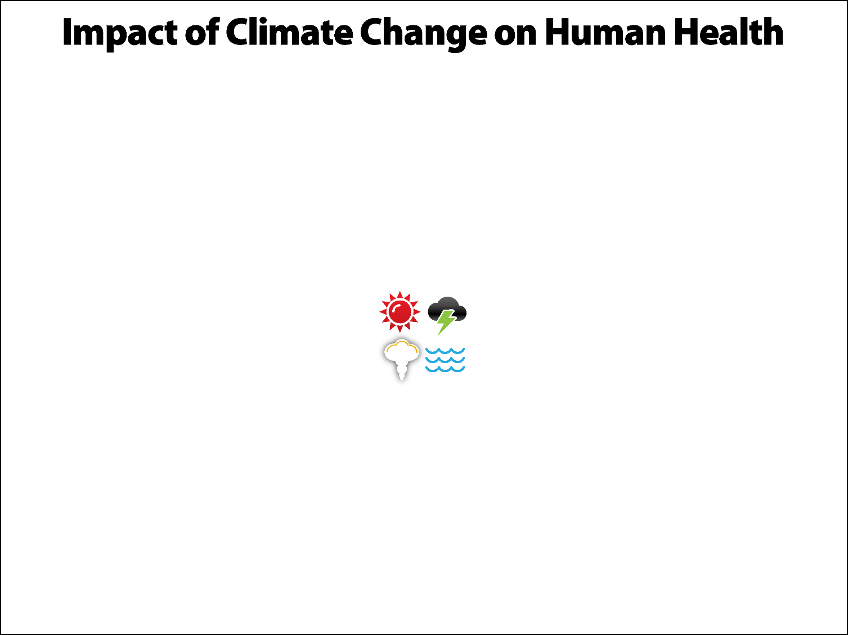
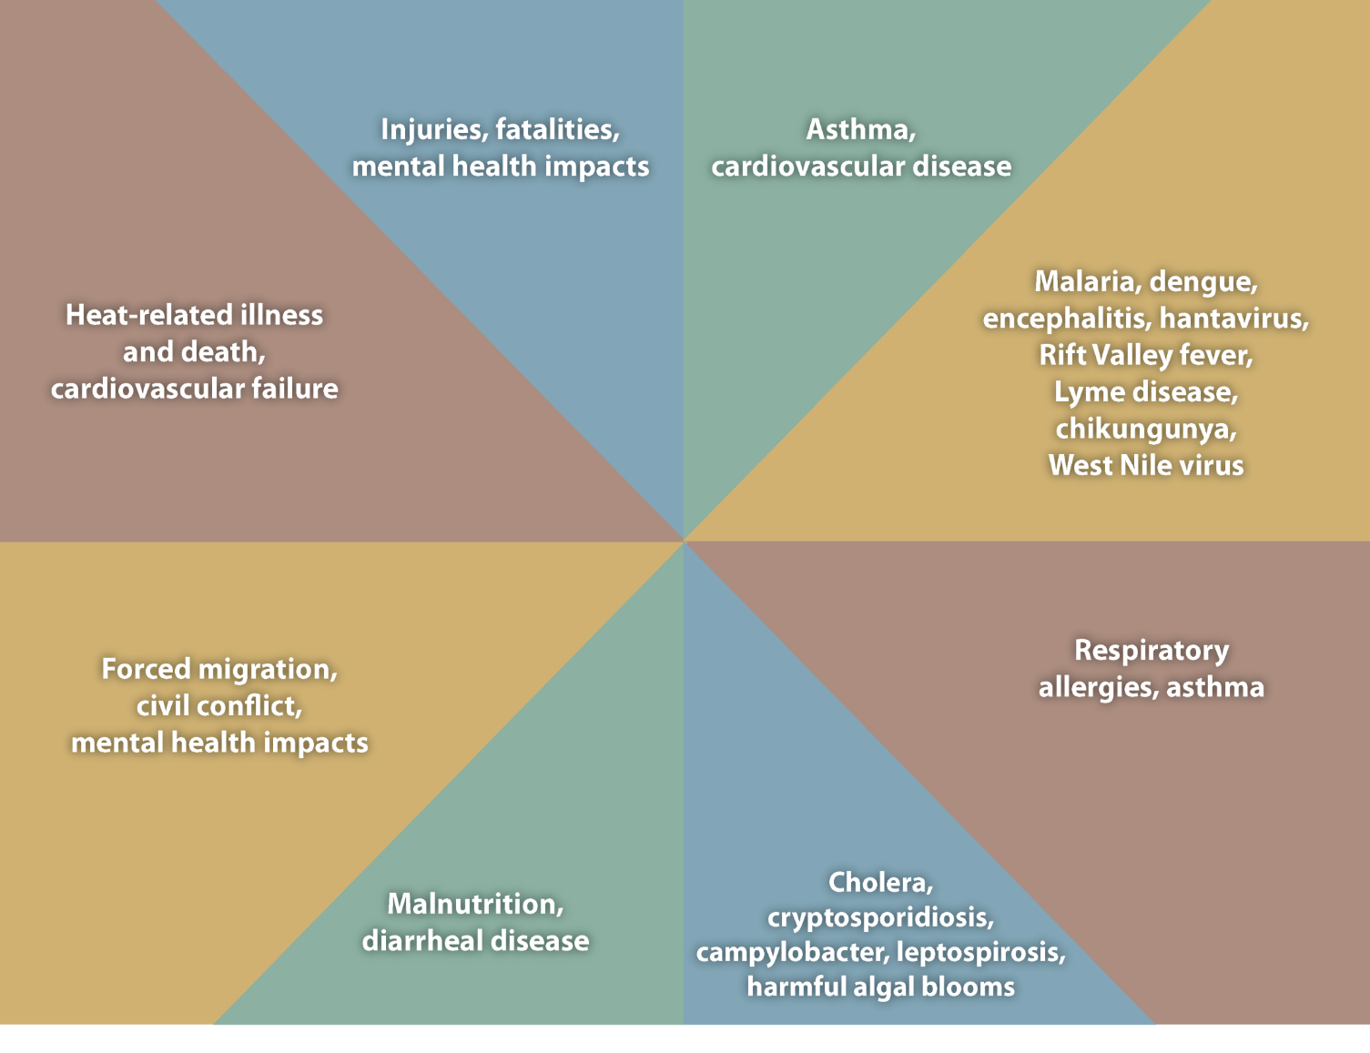
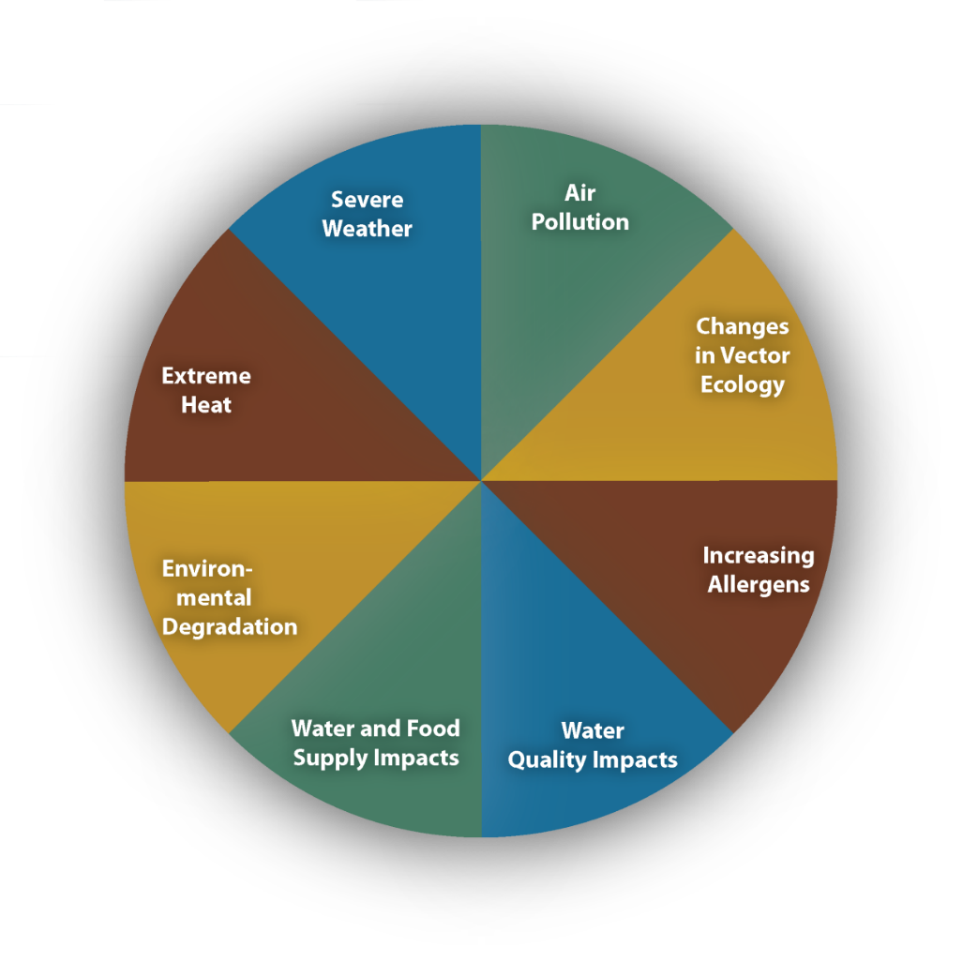
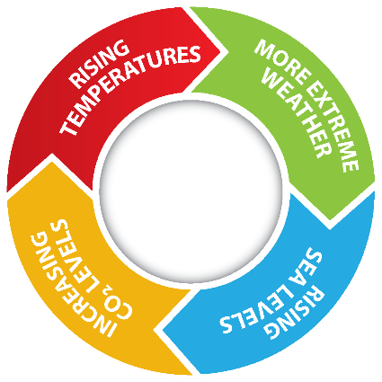
Notes:
This slide illustrates the numerous downstream effects of climate change (rising temperatures, more extreme weather, rising sea levels, and increasing carbon dioxide levels). Understanding these cause and effect relationships is critical to creating alignment over the “why” of sustainability programs at the local level. This is not just about saving money or reducing resource utilization. It is about improving global health and protecting the very survival of the human race

Slide 5
Key facts
13 million deaths per year are directly attributable to environmental factors
Meeting the goals of the Paris Agreement could save about a million lives a year worldwide by 2050 through reductions in air pollution alone.
The value of health gains from reducing carbon emissions would be approximately double the global cost of implementing carbon mitigation measures.
Over 90 per cent of people breathe unhealthy levels of air pollution, largely resulting from burning fossil fuels driving climate change.
In 2018, air pollution from fossil fuels caused $2.9 trillion in health and economic costs, about $8 billion a day.
Notes:
What data supports our concerns? About 13 million deaths per year are directly attributable to environmental factors, and In 2018, air pollution from fossil fuels caused $2.9 trillion in health and economic costs, about $8 billion a day.
Over 90 per cent of people on Earth breathe unhealthy levels of air pollution, largely resulting from burning fossil fuels that also drive climate change.
But Meeting the goals of the Paris Agreement (which is to limit global warming to below 2 degrees Celsius above pre-industrial levels) could save about a million lives a year worldwide by 2050 through reductions in air pollution alone.
In terms of the cost of these programs, The value of health gains from reducing carbon emissions would be approximately double the global cost of implementing carbon mitigation measures.

Slide 6
In September 2021, the editors of 250 health journals across the globe simultaneously published a joint statement calling on world leaders to take immediate emergency action to limit global temperature increases, restore biodiversity, and protect health.
Rise in global temperature is not only detrimental to the physical and mental health of human beings but also contributes to the decline in food production—leading to malnutrition—and biodiversity that increases the prevalence of disease and rise of pandemics.
Health equity must be a central target as global efforts need to be coordinated and that wealthier countries in particular must take responsibility to act more quickly to make fundamental changes in our economies and societies to reach net-zero emissions by 2050.
Call for Emergency Action to Limit Global Temperature Increases, Restore Biodiversity, and Protect Health, New England Journal of Medicine, Sept 2021
Notes:
In response, Health professionals have recognized the need to come together with a call to action for all nations to take immediate emergency action to address climate change, highlighting the profound impact on biodiversity that leads to a rise in disease and pandemics, a decline in food production that leads to malnutrition, and global health inequity which adds increased awareness and responsibility on wealthier nations to take the lead.

Slide 7
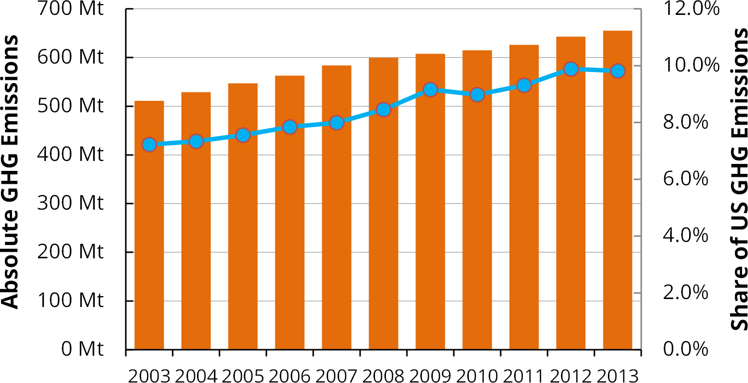
The Health Care Carbon Footprint
Health care contributes about 10% of the total carbon emissions in the United States
Matthew J. Eckelman , Jodi Sherman, Environmental Impacts of the U.S. Health Care System and Effects on Public Health https://journals.plos.org/plosone/article?id=10.1371/journal.pone.0157014
Notes:
From the health care perspective, it is important to note that among top industries, health care itself contributes about 10% of the total carbon emissions in the united states, a number that is about twice what is seen in other countries. This share continues to grow as health care itself grows as an industry

Slide 8
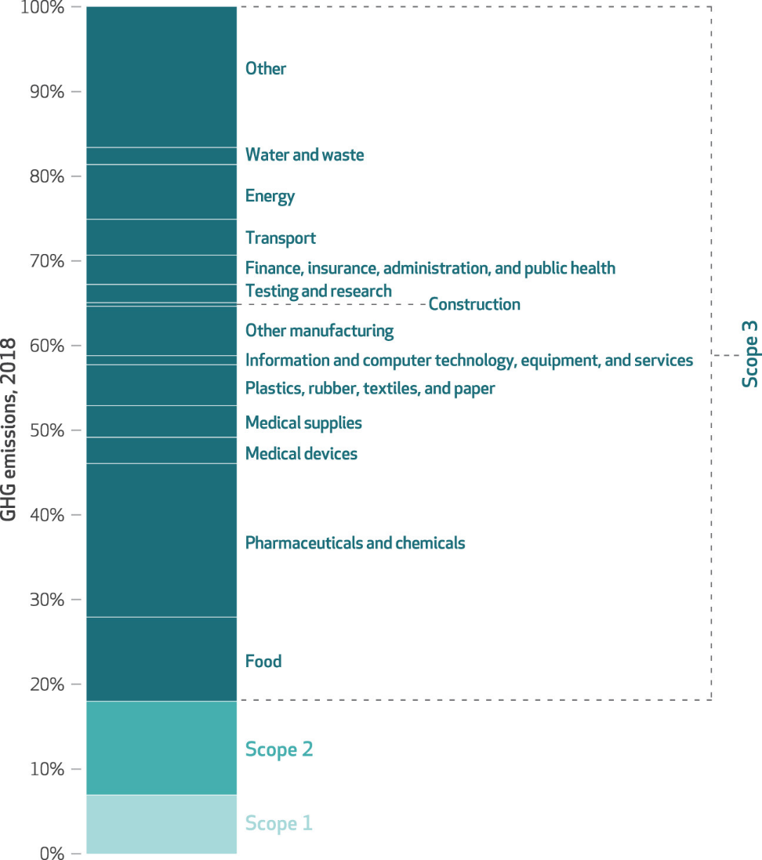
80% of Healthcare Carbon Footprint is attributable to Scope 3 (e.g. supply chain, pharmacy, device manufacturing, IT, transportation)
Health Care Pollution And Public Health Damage In The United States: An Update https://www.healthaffairs.org/doi/10.1377/hlthaff.2020.01247
Notes:
Carbon emissions is divided into three scopes, and the majority of the carbon emissions from health care come from scope 3, which includes mostly all the products, services, and technology that is utilized in delivering care to patients, including supply chain, pharmacy, medical devices and other manufacturing, IT, and transportation.

Slide 9
Overlapping with supply chain’s emissions, about 40% of health-related carbon emissions is produced at hospitals. Half of this comes from operating rooms, mostly through anesthesia gases, energy use and surgical supplies, a major source being disposable single-use medical devices.
U.S. health care GHG emissions
Hospital/Facility-based ~40%
Operating room ~30-50%
Anesthesia gas ~ 5-60%
Notes:
Of the health care related carbon emissions, about 40% come directly from hospitals, half of which is from operating rooms, mostly through anesthesia gases, energy use and surgical supplies, which includes single use devices and sterile processing

Slide 10
Benefits of a sustainability program
Environmental Impact Reduction
Contribute to the broader efforts of environmental conservation and preservation.
Cost Savings
Efficiency and waste reduction
Tax incentives
Improved Health Outcomes
Healthier community
Reduction of chemical and microbial exposures to staff
Enhanced Reputation and Community Engagement
Demonstrates a commitment towards responsible and ethical practices
Enhance the organization’s reputation in the community and attract patients, clinicians, investors
Regulatory Compliance and Risk Mitigation
Meet certain regulatory requirements
Mitigate environmental, societal, and financial risks,
Be prepared to adapt to changing regulatory landscapes and potential disruptions.
Notes:
So why build a sustainability program? What are the direct benefits to the hospital? Besides the direct reduction of carbon emissions and positively impacting the health outcomes of your communities, there are some business related benefits, such as significant cost savings through reduction in waste and supply expenses. A healthier hospital staff means fewer absences and less utilization of health insurance. The hospital gains a positive image by demonstrating a commitment toward serving the community through responsible and ethical practices, which attracts more patients, aligned clinicians and other stakeholders. Sustainability programs can also help meet regulatory compliance and mitigate risks, and hospitals can also receive a sustainable health care certification through the Joint Commission, an accrediting body that sets standards of care and operations for hospitals.

Slide 11
Next steps for hospitals
Commit to a specific goal for carbon-neutrality and establish accountable leadership
Eliminate or reduce use of harmful chemicals in hospital operations
Opt for renewable energy sources
Advocate for legislation and regulatory policies that ease ability to implement sustainable practices
Use less toxic materials and implement environmentally-friendly designs for new construction and renovations
Implement environmental sustainability in supply chain operations and procurement
Adopt sustainable practices in care delivery
Notes:
Here are some steps that hospitals can take toward creating a sustainability program.

Slide 12
Anesthetic gases
desflurane
isoflurane
sevoflurane
POTENT
mtCO₂e / liter
3.72
0.76
0.20
desflurane
isoflurane
sevoflurane
PERSISTENT
atmospheric
lifetime (yr)
14
3.2
1.1
desflurane
isoflurane
sevoflurane
PERVASIVE
Antarctica atmos.
(ppt)
0.32
0.12
0.23
Anes Analg 2012; 14(5): 1081-5.
J Phys Chem A. 2005; 109(2): 337-46.
Geophys Res Lett. 2015; 42: 1606-11.
Notes:
Here is real life example of a successful program to reduce carbon emissions: reducing the impact of anesthetic gases. It is well known that of the three most commonly used anesthetic gases, desflurane has the most potent and long last greenhouse gas effect, about 14 times worse than the next commonly used gas, sevoflurane. Desflurane also happens to be typically more expensive than sevoflurane.

Slide 13
Variation in anesthesia choice
Individual Clinicians… 2016, Providence Oregon Hospitals.
Chung, J. and Chesebro, B., “Choose the Environment: The Sustainable Practice of Anesthesia Gas Standardization” American College of Medical Quality, Volume 36 Supplement 4S Supplement 1 2021
Notes:
In 2016, one of my colleagues Dr. Chesebro, an anesthesiologist at Providence, researched the variations in anesthetic gas choice by anesthesiologists practicing at 8 hospitals in the Oregon region. In this slide, each vertical line represents an individual anesthesiologist, and the color shows the percentage of cases where desflurane, sevoflurane, and isoflurane was used, in blue, yellow, and pink, respectively. There is no clinical reason to explain this much variability, other than simple physician preference. That is, there is no strong evidence that one gas has better clinical outcomes than another, and there are no standardized guidelines that are followed by anesthesiologists. It is very common among physicians to choose products and techniques based on personal experience rather than actual data or evidence, even when evidence exists to support standardizing practices.

Slide 14
Reducing desflurane use
2016.2
2018.2
2016.2
2018.2
Chung, J. and Chesebro, B., “Choose the Environment: The Sustainable Practice of Anesthesia Gas Standardization” American College of Medical Quality, Volume 36 Supplement 4S Supplement 1 2021
Notes:
Over the next two years, Dr. Chesebro worked with the anesthesiologists to share data and align them to goals of reducing GHG effects. As you can see, use of desflurane dramatically decreased over the years as well as more efficiency use of sevoflurane, and they were able to reduce not only the GHG emissions but also the overall cost of anesthesia gas use. And while these changes were occurring, there was no negative impact on patient care, as indicated by time to get the patient our of the OR and how long it took for the patient to recover in the post anesthesia care unit.

Slide 15
The Reprocessing Cycle
How
Reprocessing
Reprocessing devices for reuse is regulated by the FDA and requires approval similar to other medical devices
Collection
Medical equipment are collected in special bins for reprocessing after cases
1
Cleaning and inspection
Collected medical supplies undergo a multi-step cleaning and inspection process
Distribution
Devices are sent to hospitals for repeat use
5
2
Repackaging and sterilization
Devices are repackaged, sterilized, and re-inspected again prior to distribution
Refurbishing and testing
Devices are refurbished to full functionality and to tested to show substantially equivalent state to FDA-cleared OEM device
4
3
Notes:
Another example is reprocessing and reusing single-use surgical devices. Many surgical devices are disposable, designed to be single use only, ostensibly because of the risk of infection, or because certain components cannot be re-sterilized. Many of these products are low-cost plastics such as catheters and tubes, but some products cost hundreds, possibly thousands of dollars, such as surgical staplers, energy devices, sawblades, drill bits, cardiac wires and probes, and other potentially reusable products. While some of these products could easily be resterilized and reused, some of the barriers against this practice include the high cost of reprocessing, resistance from the original manufacturers, and unfounded fear by clinicians that reusing a product poses risks to the patients such as infection and poor quality. However, reprocessing companies do exist and are overseen by the FDA.

Slide 16
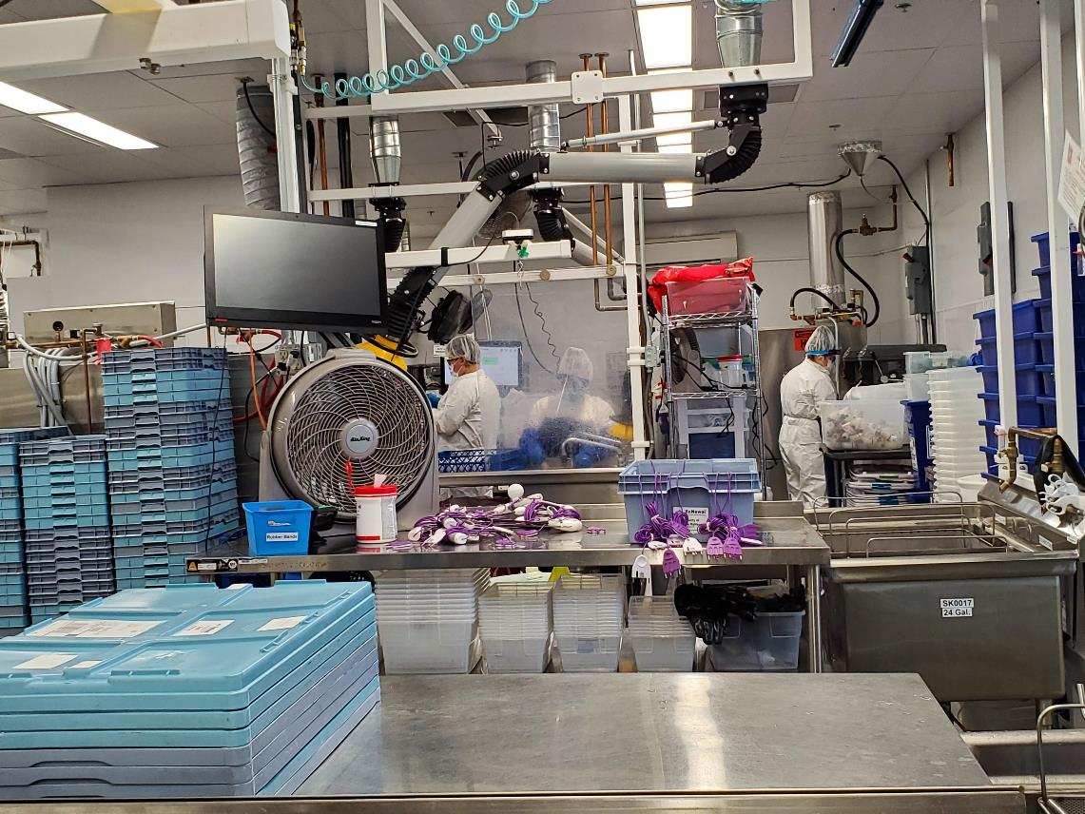
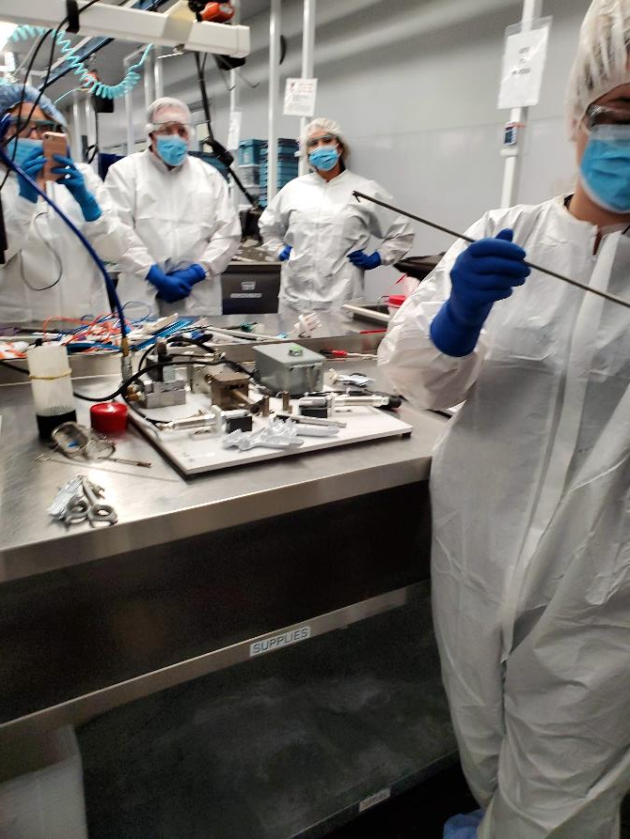
Notes:
Here are some pictures of one of these companies. Here, Reprocessing is more than just simply sterilizing a used product and repackaging it. In this example of reprocessing a Ligasure device, each product is actually taken apart, carefully inspected and reassembled to meet standards higher than the original manufacturing, testing each product before packaging. This is because a reprocessed product that fails during patient use will be seen as a failure of the entire reprocessing system, whereas a failed original product would simply be seen as an outlier.

Slide 17
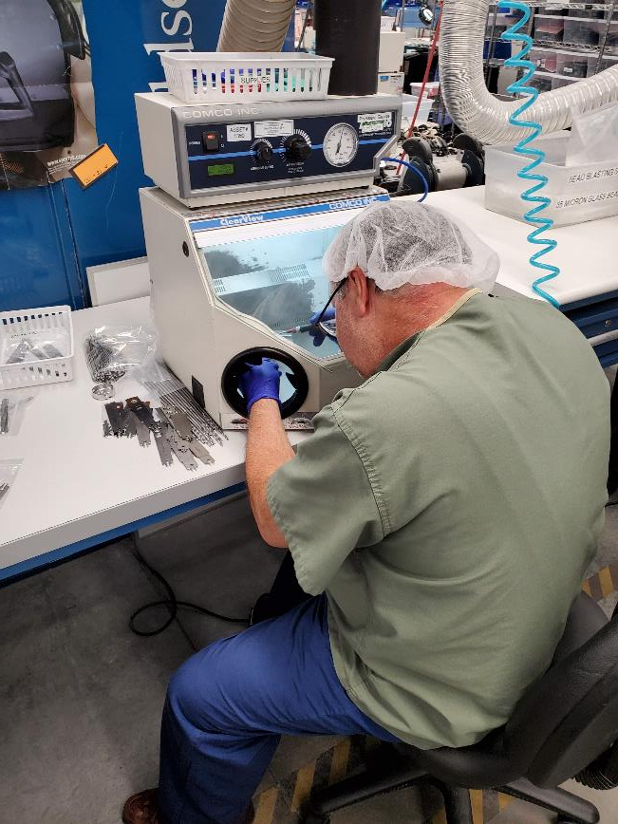
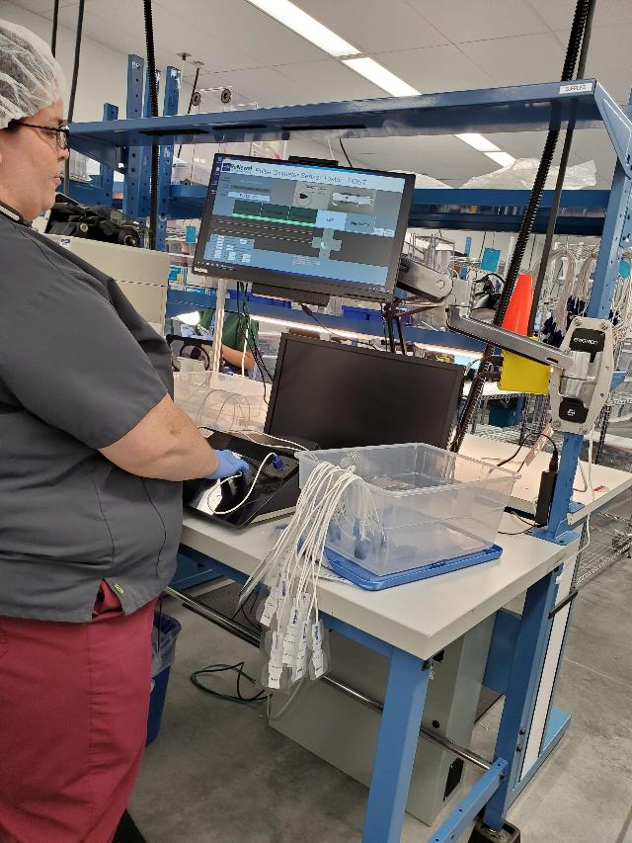
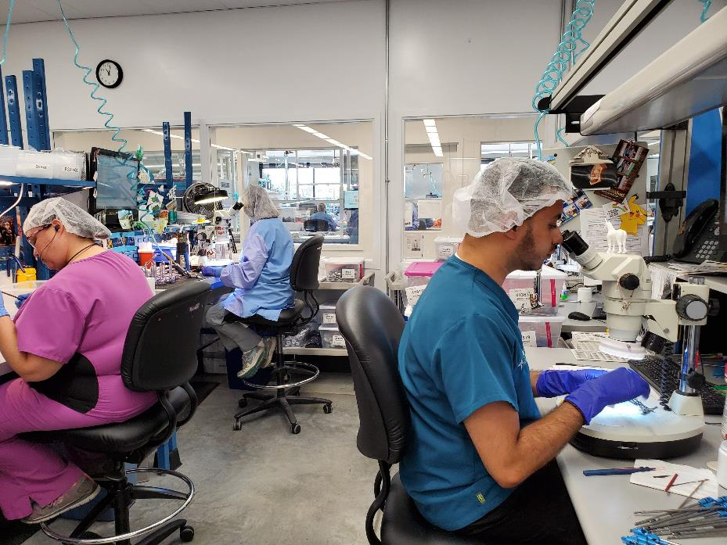
Notes:
Again, here Each product is hand tested before being packaged for resale, and thus undergoing a more rigorous quality assurance process.

Slide 18
Reprocessed products may have superior quality
Comparison of OEM versus RP devices
 | Defects | Purchases | Defect rate (%) | Z-score | p-value
All devices
OEM | 28 | 1393 | 2.01
RP | 7 | 1719 | 0.41
OEM versus RP | — — — | — — — | — — — | 4.216 | <0.001
US
US OEM | 12 | 680 | 1.76
US RP | 3 | 1036 | 0.29
OEM versus RP | — — — | — — — | — — — | 3.211 | 0.0013
BD
BD OEM | 16 | 713 | 2.24
BD RP | 4 | 683 | 0.59
OEM versus RP | — — — | — — — | — — — | 2.607 | 0.009
US=Ultrasonic
BD=Bipolar Diathermy
T. Loftus, Journal of Medical Devices, DECEMBER 2015, Vol. 9
Notes:
There is some suggestion that the quality of reprocessed products actually may be superior to original devices. In this study that was published about 10 years ago, another colleague of mine, Dr. Loftus originally intended to show that reprocessed products had worse quality than original products. OEM stands for original equipment manufacturer and RP stands for reprocessed product. To his surprise, his study showed exactly the opposite, that reprocessed products actually demonstrated fewer defects in clinical use than the OEM products. This might be partially due to the careful inspection and testing of each product for reprocessing, as opposed to the random sampling quality checks of OEM products.

Slide 19
Reprocessed device conversion
Single large volume hospital where the use of reprocessed tissue sealers was about 1% (compared to system average of about 40%).
PDSA cycle x 3 months: use increased to about 30%, resulting in about $25K annualized savings to the hospital without quality issues.
Notes:
One example of reprocessed product conversion I’d like to share is a project that I worked on at a single hospital, where the use of reprocessed tissue sealers during laparoscopic surgeries was only about 1%. This signaled a huge opportunity for savings and carbon reduction. Over a short period of time, using a PDSA cycle (which stands for plan do study act, a commonly used process improvement technique), use increased to 30% that resulted in significant savings without quality concerns. This is an example that shows that conversion to a cost effective, sustainability program can be done rapidly with good results, even in a small setting with little resources.

Slide 20
EP catheter reprocessing: Savings - Year to Date
 | 2021 | 2022 | 2023 | 2024 | 2025 Projected
Total | $394,000 | $643,000 | $1.6M | $2.0M | $2.5M+
Notes:
In another more recent example, at bon secours mercy health, we embarked on a reprocessing program in 2021 for electrophysiology catheters. These can often cost in the thousands for a new catheter. The cost savings were significant, and continues to grow as more clinicians become comfortable with using reprocessed products.

Slide 21
Savings – magnified view
Product | OEM $ | Reprocessed $ | Savings $ | Note
Catheter A | $2300 | $715 | $1585 | Note: used in every Afib case
Catheter B | $565 | $110 | $450 | Used in substantial amount of cases
Notes:
This demonstrates the significant cost difference between two commonly used new and reprocessed products, where we saved almost $1600 for each catheter used

Slide 22
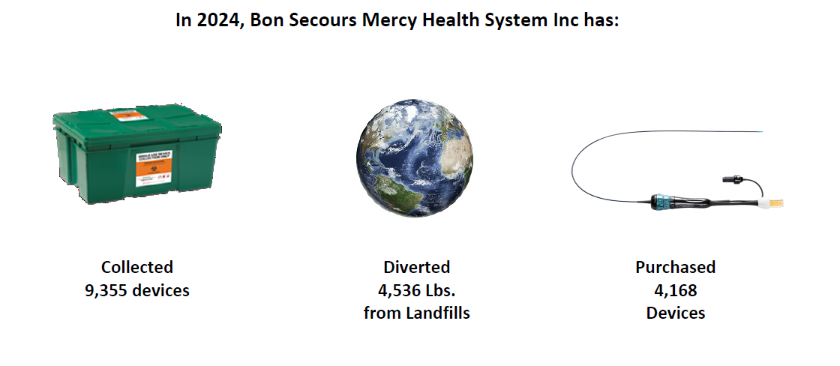

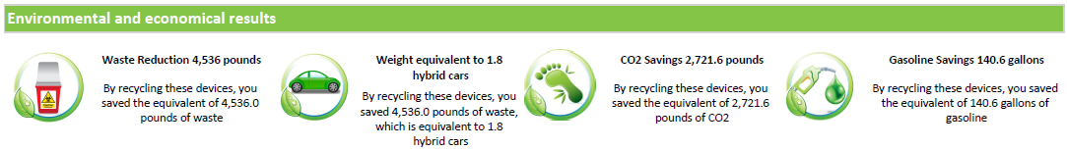
BSMH Health System
1 health system
1 department - EP
YTD 2024 Jan-September
EP reprocessing purchases: ~$1,301,738
EP Reprocessed savings: ~$1,856,868
Reprocessing
How much can one hospital system actually help the environment?
Notes:
And reprocessing not only saves money through the lower price, but also by reducing waste. Reduction of waste directly reduces the cost of waste management, but the impact on carbon emissions and climate change were also significant.

Slide 23
Summary
Climate change is a major threat to human health
Health care is responsible for a major portion of carbon emissions
Health care leaders should take immediate action to reduce carbon emissions
Sustainability programs have multiple benefits to patients, communities, and the hospital itself
Sustainability projects can be successfully implemented in surgeries without quality issues
Notes:
Thank you again for joining me for this presentation, and I hope it provided you with some insights and ideas on climate change and sustainability, and what physicians and hospitals can do to create a sustainability program and lead the efforts to reduce health care’s carbon footprint and improve the health of our communities.

Slide 24


Thank you!

