Slide 1



Leadership Management in Healthcare
Quality Improvement: PDSA cycle
Lonika Sood, MBBS MHPE FACP
Associate Professor of Medical Education and Clinical Sciences
Course Director, LMH 521
Notes:
In this module, we will discuss how by testing changes on a small scale and tracking your results as you go, you can see changes that are affecting the process you're trying to improve. The testing phase in the Model for Improvement, is the PDSA (Plan-Do-Study-Act). PDSA cycles allow you to conduct rapid tests of change, to grow your learning quickly while minimizing the risk of introducing a change in a complex system.

Slide 2
Disclosure
No relevant financial disclosures
Adapted from the Institute for Healthcare Improvement modules on QUALITY IMPROVEMENT
Use statement
WARNING: COPYRIGHT RESTRICTIONS This course content and all writings and materials provided to you at the Elson S. Floyd College of Medicine are protected by federal copyright law and Washington State University policy. The content is copyrighted by the Washington State University Board of Regents or licensed to the Elson S. Floyd College of Medicine by the copyright owner. Limited access to this content is given for personal academic study and review purposes of registered students and faculty of Elson S. Floyd College of Medicine. You shall not otherwise copy, share, distribute, modify, transmit, upload, post, republish, reuse, sell, gift, rent, lend or otherwise disseminate any portion of this course content without permission in writing, signed by an individual authorized by Washington State University. Unless otherwise noted, images © stock.adobe.com.

Slide 3


Collaboration
Please reach out with your thoughts and questions! Lonika.sood@wsu.edu
This is a safe learning environment.

Slide 4
Objectives
After completing this lesson, you will be able to:
Explain the importance in improvement work of conducting iterative small-scale tests of change.
Describe what happens during each stage of PDSA testing (i.e., what happens during "plan," "do," "study," and "act")
Use a PDSA worksheet to plan and conduct a small test of change for your own personal improvement project.

Slide 5
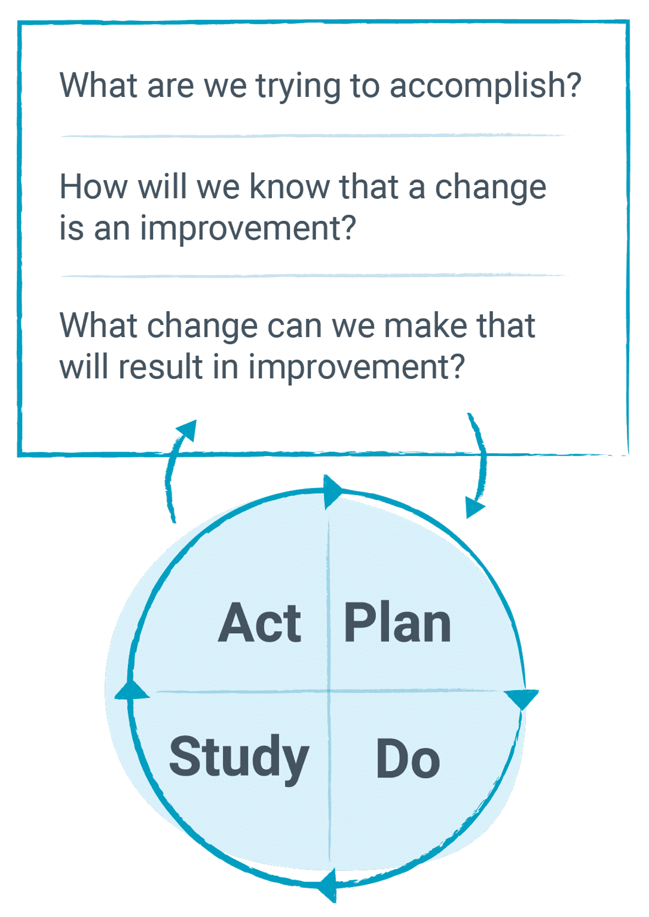

Model for Improvement
Test the idea for a change
Why is the PDSA an essential and unique component of the Model for Improvement.
Video: Link here

Slide 6

Model for Improvement
Test the idea for a change

Slide 7
What is the PDSA Cycle comprised of?

Slide 8
PDSA cycle
Plan: We have a hypothesis and are making a prediction about what will happen when we run this experiment, and we’re going to determine whether or not the prediction holds up.
Do: Running the experiment
Study: We see whether or not our prediction was verified when we acted on our plan. Based on what we find on the data we get from the PDSA, we then revise our plan if necessary
Act: To change our plan and develop another hypothesis and then run another experiment.
Click on the play button to see what happens at each step:
Video: Link here

Slide 9

PDSA cycle

Slide 10
PDSA cycle
Plan
What information is important to collect?
Why is it important?
Who will collect the data?
Who will analyze the data prior to “Study”?
Where will data be collected?
When will data collection take place?
How will the data (measures or observations) be collected?

Slide 11
PDSA cycle
Do
Run the test on a small scale.
Carry out the test.
Document problems and unexpected observations.
Collect and begin to analyze the data.

Slide 12
PDSA cycle
Study
Analyze the results and compare them to your predictions.
Complete analysis of the data.
Compare the data to your prediction.
Summarize and reflect on what you learned.

Slide 13
PDSA cycle
Act
Based on what you learned from the test, make a plan for your next step..
  Adapt (make modifications and run another test)
  Adopt (test the change on a larger scale)
  Abandon (don’t do another test on this change idea).
Prepare a plan for the next PDSA.

Slide 14

Case study
The FQHC
Setting: Multidisciplinary ambulatory practice providing care for substance abuse, mental health, and developmental disabilities.
Opiate-addicted patients have access to an integrated treatment program that consists of counseling, primary care, and Suboxone (buprenorphine) therapy. To receive Suboxone, patients must have a prior authorization from their prescribing physician.
For a long time, the PA process was a significant source of trouble.

Slide 15
Case study
The FQHC
Set the aim for the improvement project: ’Decrease the wait time for prescription pick-up for Suboxone patients by having zero prior authorization requests for two weeks by March 31’
Notes:
Reviewed patient satisfaction survey results and shadowed staff members.
Set the aim for the improvement project: ’Decrease the wait time for prescription pick-up for Suboxone patients by having zero prior authorization requests for two weeks by March 31’

Slide 16
Case study
The FQHC
Established the following measures:
Outcome: Rate of PA-related prescription denials by week (numerator = number of denials on day of Suboxone pick-up; denominator = number of Suboxone pick ups on each day)
Process:
  Number of errors about missing or late paperwork per week
  Average time needed to complete one PA
  Percentage of daily medical assistant tasks completed each day using the new checklist
Balancing:
  Rate of successful completion of all paperwork (numerator = number of errors identified by hospital and sent back for re-completion; denominator = number of forms sent to hospital)
  Medical assistant job satisfaction

Slide 17
Case study
The FQHC
Decided on a small goal to test

Slide 18
Case study
The FQHC
First change they would test: Expanding the medical assistant's role - test making them responsible for administrative tasks related to Suboxone
Give them a checklist of all the tasks for tracking, completing, and documenting PAs.
The team predicted if they organized and standardized all the processes related to PAs, the MA would be able to complete the full list of tasks on the checklist, and they would see their key measures improve. They also predicted the enhanced job role would improve the medical assistant's satisfaction at work.

Slide 19
Case study
The FQHC
Collected data
Made observations
Offered support
Made changes as needed and documented responses

Slide 20
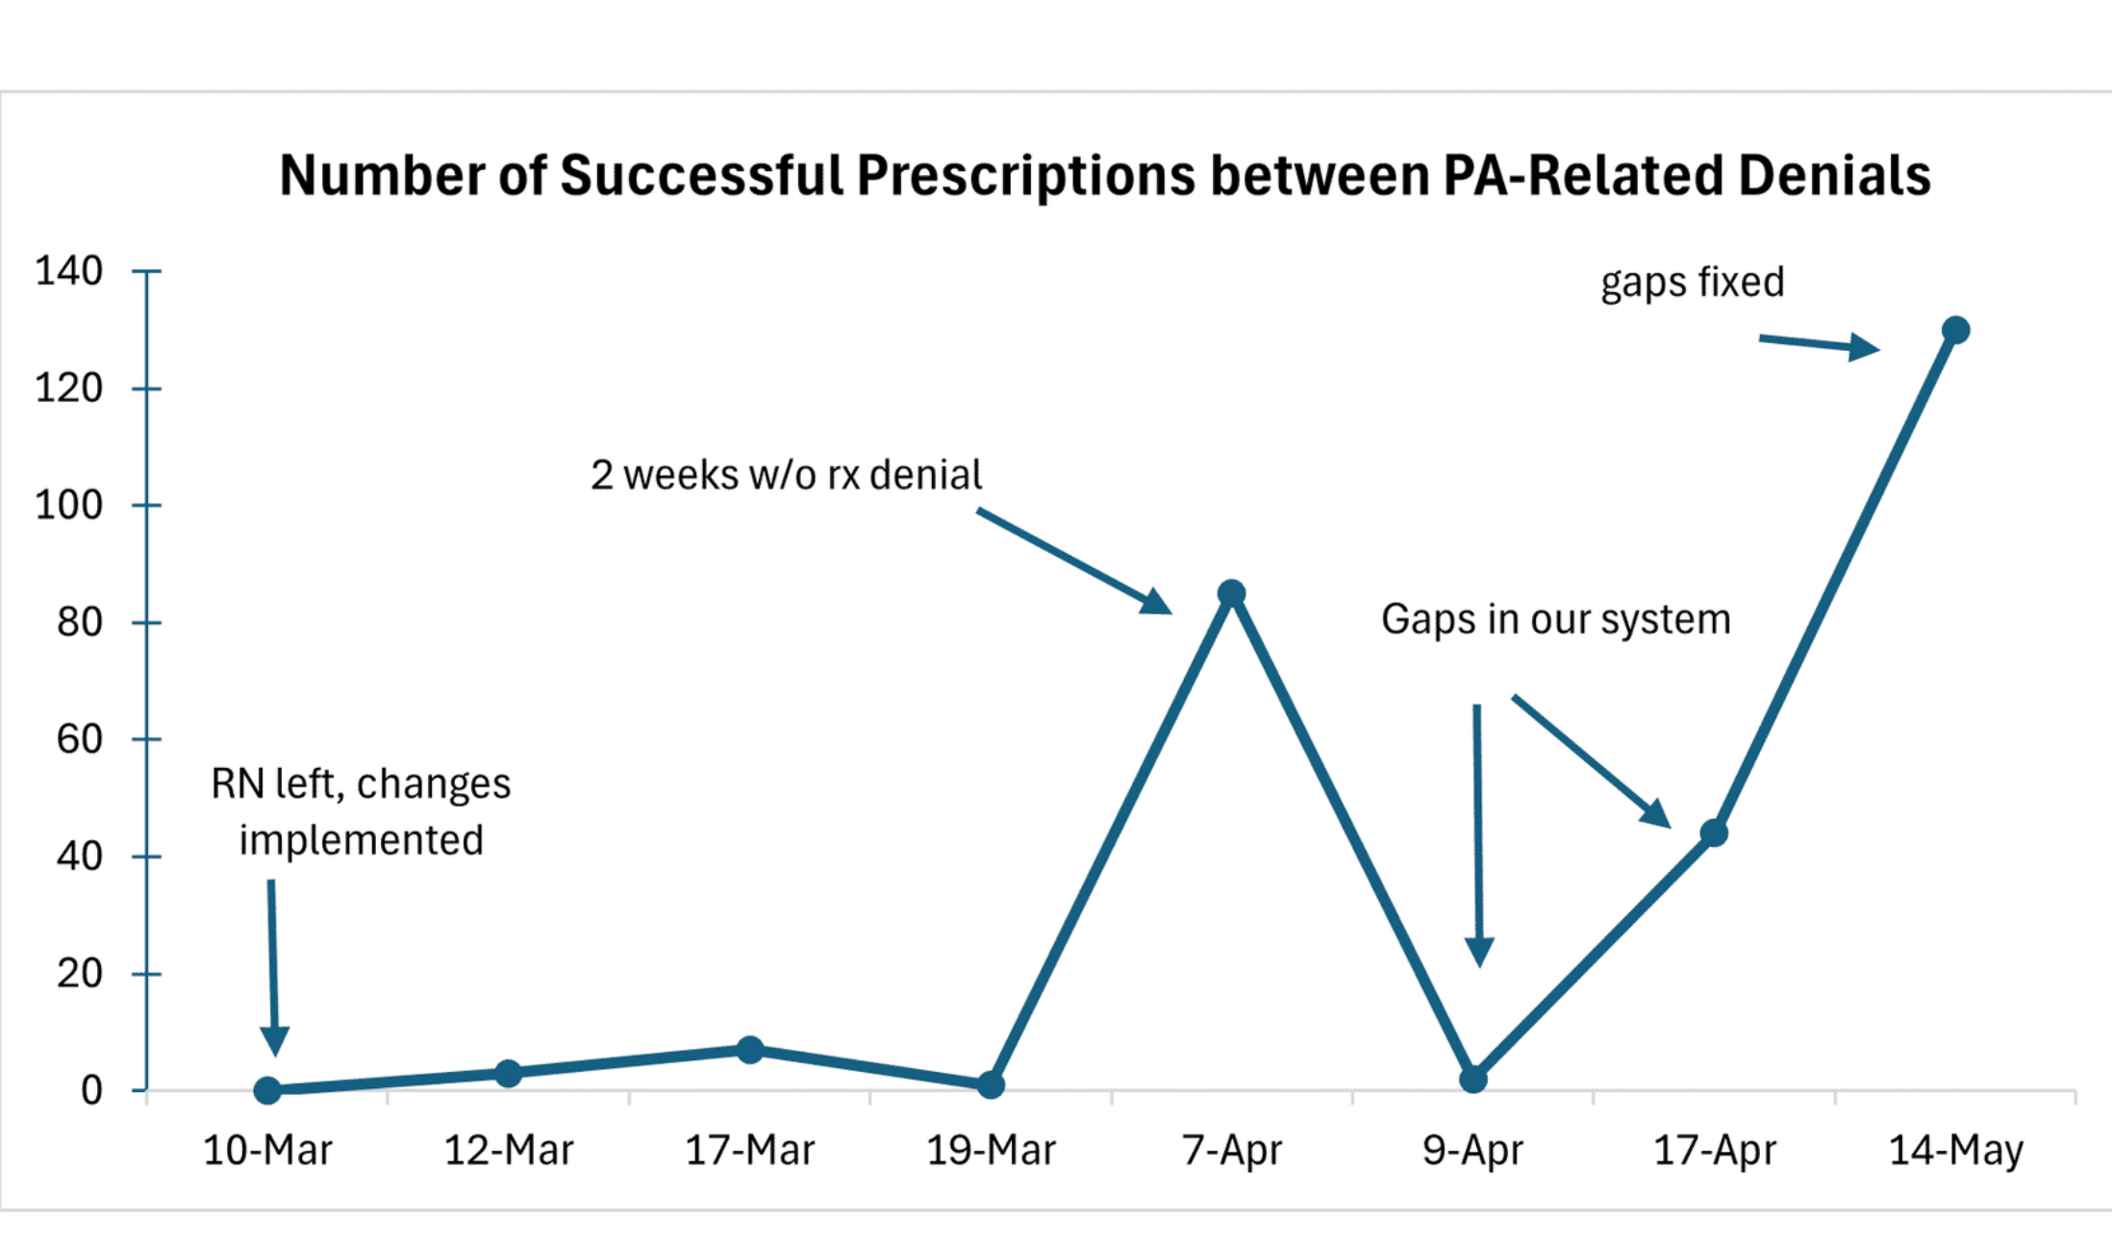
Case study
The FQHC

Slide 21
Case study
The FQHC
An expanded role for the medical assistant
A checklist for Suboxone-related tasks
Added more days for patients to pick up medications
Now… there is no wait for patients!!

Slide 22
References
IHI Course QI 102, Lesson 5

