Slide 1


Leadership Management in Healthcare
Quality Improvement: Model for Improvement
Lonika Sood, MBBS MHPE FACP
Associate Professor of Medical Education and Clinical Sciences
Course Director, LMH 521

Slide 2
Disclosure
No relevant financial disclosures
Adapted from the Institute for Healthcare Improvement modules on QUALITY IMPROVEMENT
Use statement
WARNING: COPYRIGHT RESTRICTIONS This course content and all writings and materials provided to you at the Elson S. Floyd College of Medicine are protected by federal copyright law and Washington State University policy. The content is copyrighted by the Washington State University Board of Regents or licensed to the Elson S. Floyd College of Medicine by the copyright owner. Limited access to this content is given for personal academic study and review purposes of registered students and faculty of Elson S. Floyd College of Medicine. You shall not otherwise copy, share, distribute, modify, transmit, upload, post, republish, reuse, sell, gift, rent, lend or otherwise disseminate any portion of this course content without permission in writing, signed by an individual authorized by Washington State University. Unless otherwise noted, images © stock.adobe.com.

Slide 3


Collaboration
Please reach out with your thoughts and questions! Lonika.sood@wsu.edu
This is a safe learning environment.

Slide 4
Objectives
After completing this lesson, you will be able to:
Identify the key elements of an effective aim statement
Describe three kinds of measures: process measures, outcome measures, and balancing measures.
State and use the five approaches to coming up with a change
Explain how to use change concepts to come up with good ideas to test.

Slide 5
Setting the Aims statement

Slide 6
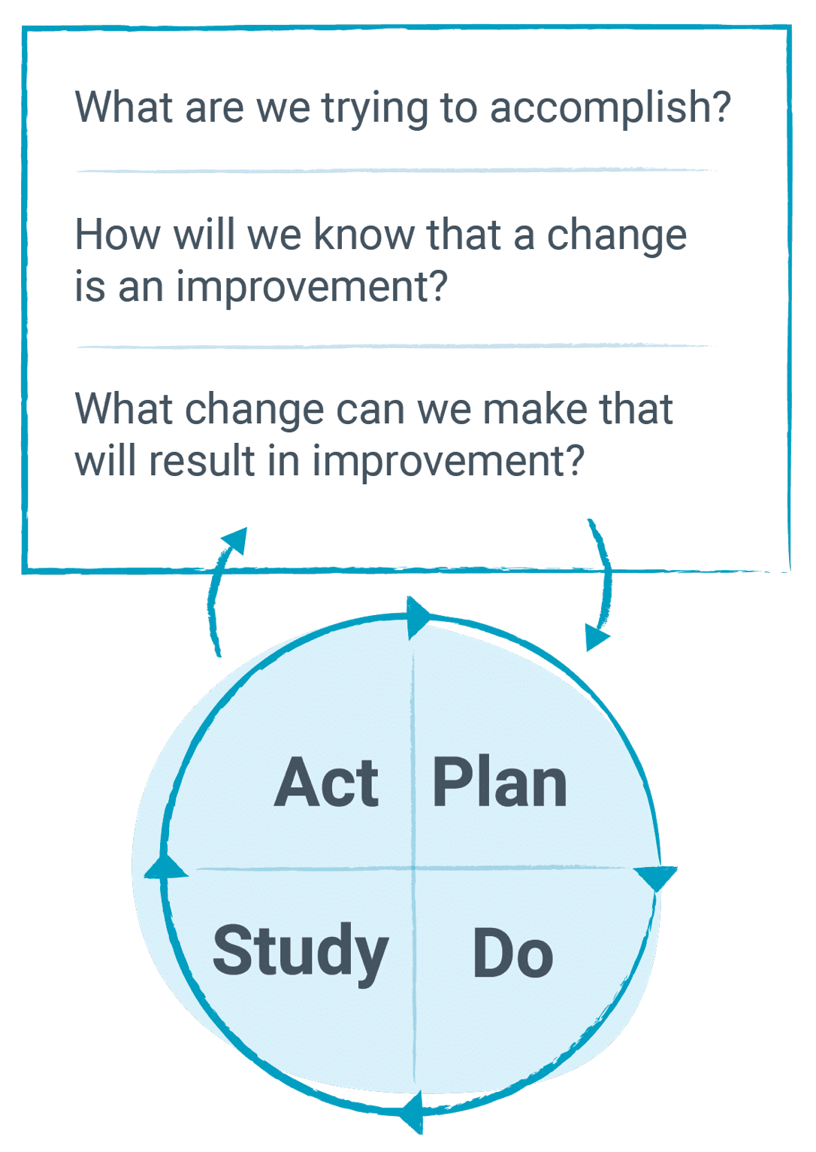

Model for Improvement
PDSA cycle: Setting the Aims statement
How to ask the right questions and then the PDSA cycle
Video: Link here

Slide 7
Aims statement
A good aim addresses an issue that is important to those involved
It is specific, measurable, and addresses these questions:
How good?
By when?
For whom (or what system)?

Slide 8


Aims statement
I'm going to exercise more often.
We'll do better on tests.
I'm going to run at least 10 miles per week by September 4.
Every member of my study group will increase their grade point average by 10 percent or more within eight months.

Slide 9
Guideline for setting an improvement aim
Make a decision about what you are going to try to improve, and state it
Make sure it is important, meaningful
Try to set an aim that you think you could track progress on
Be ambitious

Slide 10
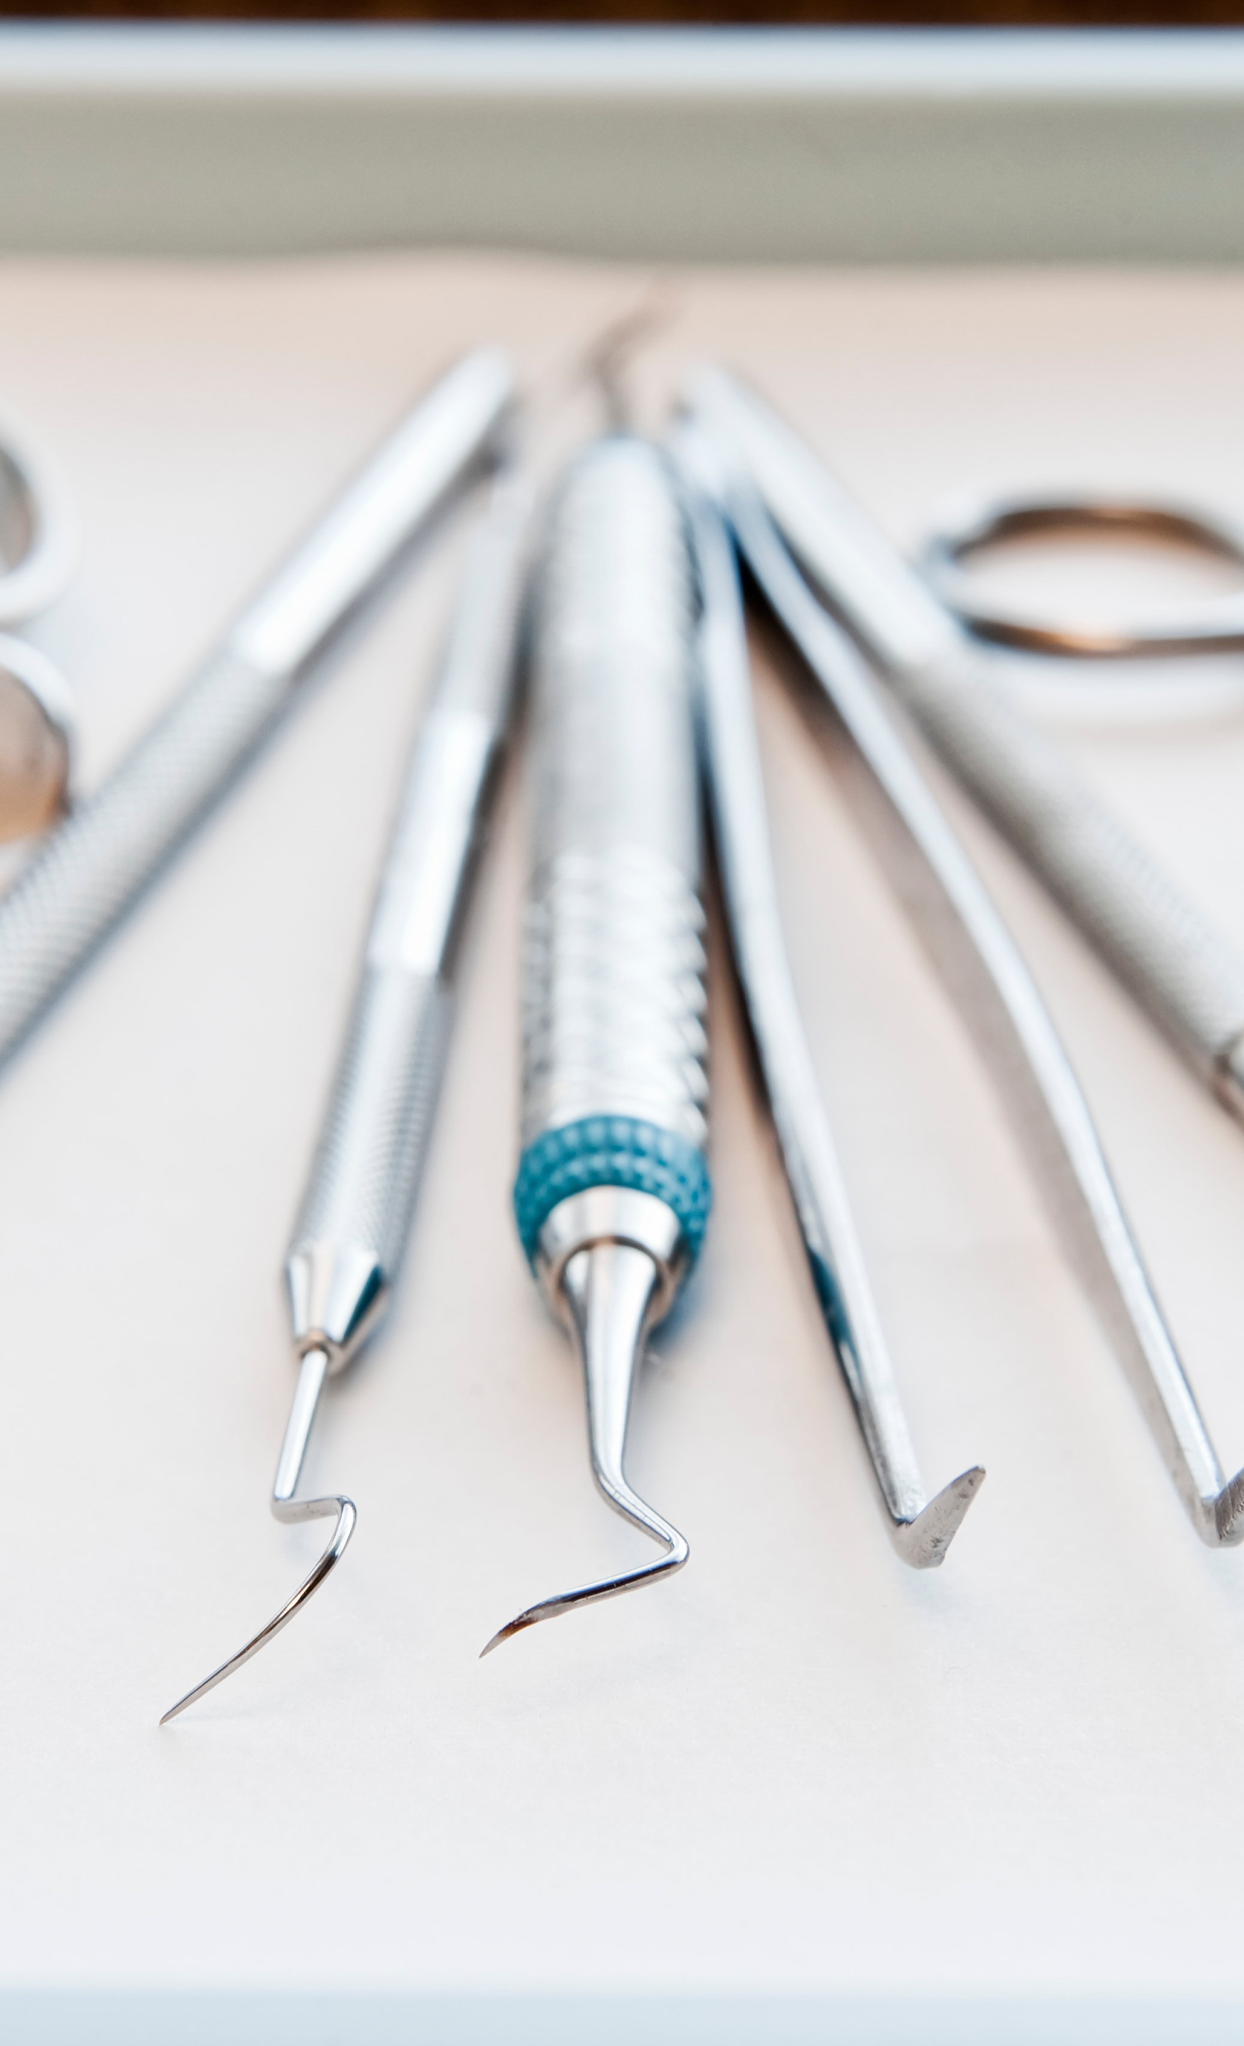
Case study
The Dental Clinic
Brenda, the office manager at a dental practice, noticed many patients were missing their appointments. With the help of her staff, she decided to conduct a small improvement project to improve the process for reminding patients of upcoming visits, with the goal of having fewer "no shows."

Slide 11
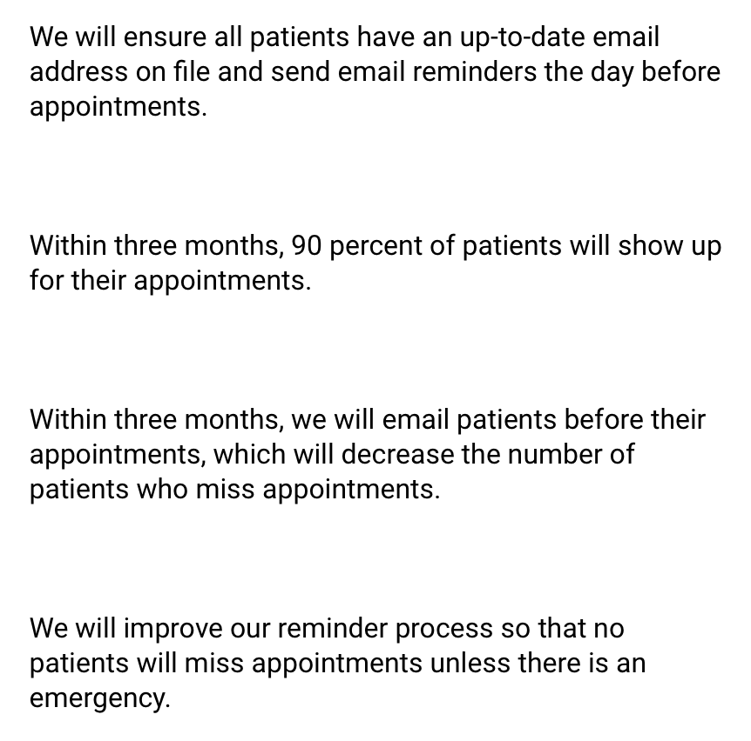

Case study
The Dental Clinic
Which of the following is the most effective aim statement for this project?

Slide 12
Model for Improvement
PDSA cycle: Establishing Measures
Specifically, data will help you:
Understand current performance
Come up with ideas to improve the process.
Test changes to see if they lead to improvement
Ensure improvements are being maintained.

Slide 13
Three types of measures:
Outcome measures
Measures you want to move
Tell you how the system is performing
Process measures
Tell you if parts in the system are performing as planned
Balancing measures
Not directly related to the aim
Assess whether the changes designed to improve one part are introducing problems elsewhere

Slide 14
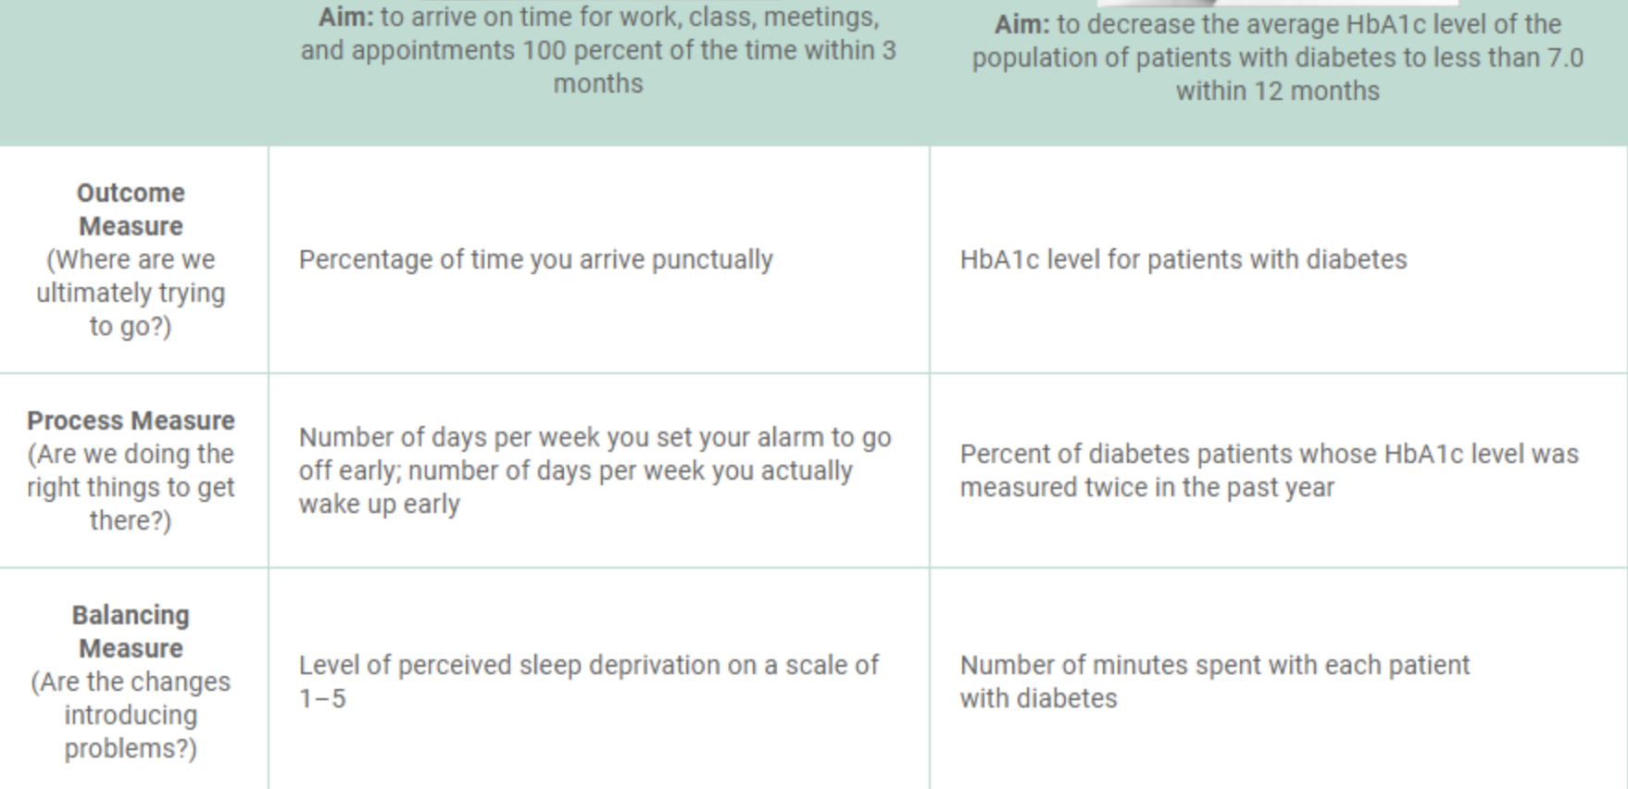

Slide 16

Quiz
Aim: Reduce the average waiting time for all patients to under 20 minutes by next December.
Measure: Patient cycle times (e.g., time to registration, time from arrival to triage, time from triage to bed placement) and the percentage of time staff arrive for their shifts on time
Outcome measures
Process measures
Balancing measures
Notes:
Outcome measure

Slide 17
Quiz
Aim: Reduce the average waiting time for all patients to under 20 minutes by next August.
Measure: Percentage of staff reporting they’re satisfied at work and total staffing costs
Outcome measures
Process measures
Balancing measures
Notes:
balancing measure

Slide 18
Quiz
Aim: Reduce the incidence of ventilator-associated pneumonia (VAP) by reducing the number of ventilator days in the intensive care unit (ICU) by 20 percent within five months.
Measure: Readmission of ventilated patients to the ICU who then require mechanical ventilation
Outcome measures
Process measures
Balancing measures
Notes:
balancing measure

Slide 19
Quiz
Aim: Reduce the incidence of ventilator-associated pneumonia (VAP) by reducing the number of ventilator days in the intensive care unit (ICU) by 20 percent within five months.
Measure: Percentage of patients with ventilator-associated pneumonia
Outcome measures
Process measures
Balancing measures
Notes:
outcome measure

Slide 20

Now what….???!!
Notes:
Time can be the teacher. In the model for improvement, keeping track of things over time allows you to assess the effects of changes. So you could learn if those changes are improvements or not.

Slide 21
Developing Changes

Slide 22

Useful Ways to Develop Changes
When you’re looking for good ideas for changes to test, where do you find inspiration?
Example of how a golfer might consider ideas to improve her swing: Watch video

Slide 23
Change concepts
There are some change concepts to help improvement teams develop good ideas for changes to test:
Eliminate waste
Improve workflow
Optimize inventory
Enhance the producer-customer relationship
Change the work environment
Manage time
Manage variation
Design systems to avoid mistakes
Focus on the design of products and services
Notes:
There are some change concepts to help improvement teams develop good ideas for changes to test:
A change concept is “a general notion or approach to change that has been found to be useful in developing specific ideas for changes that lead to improvement.”

Slide 24
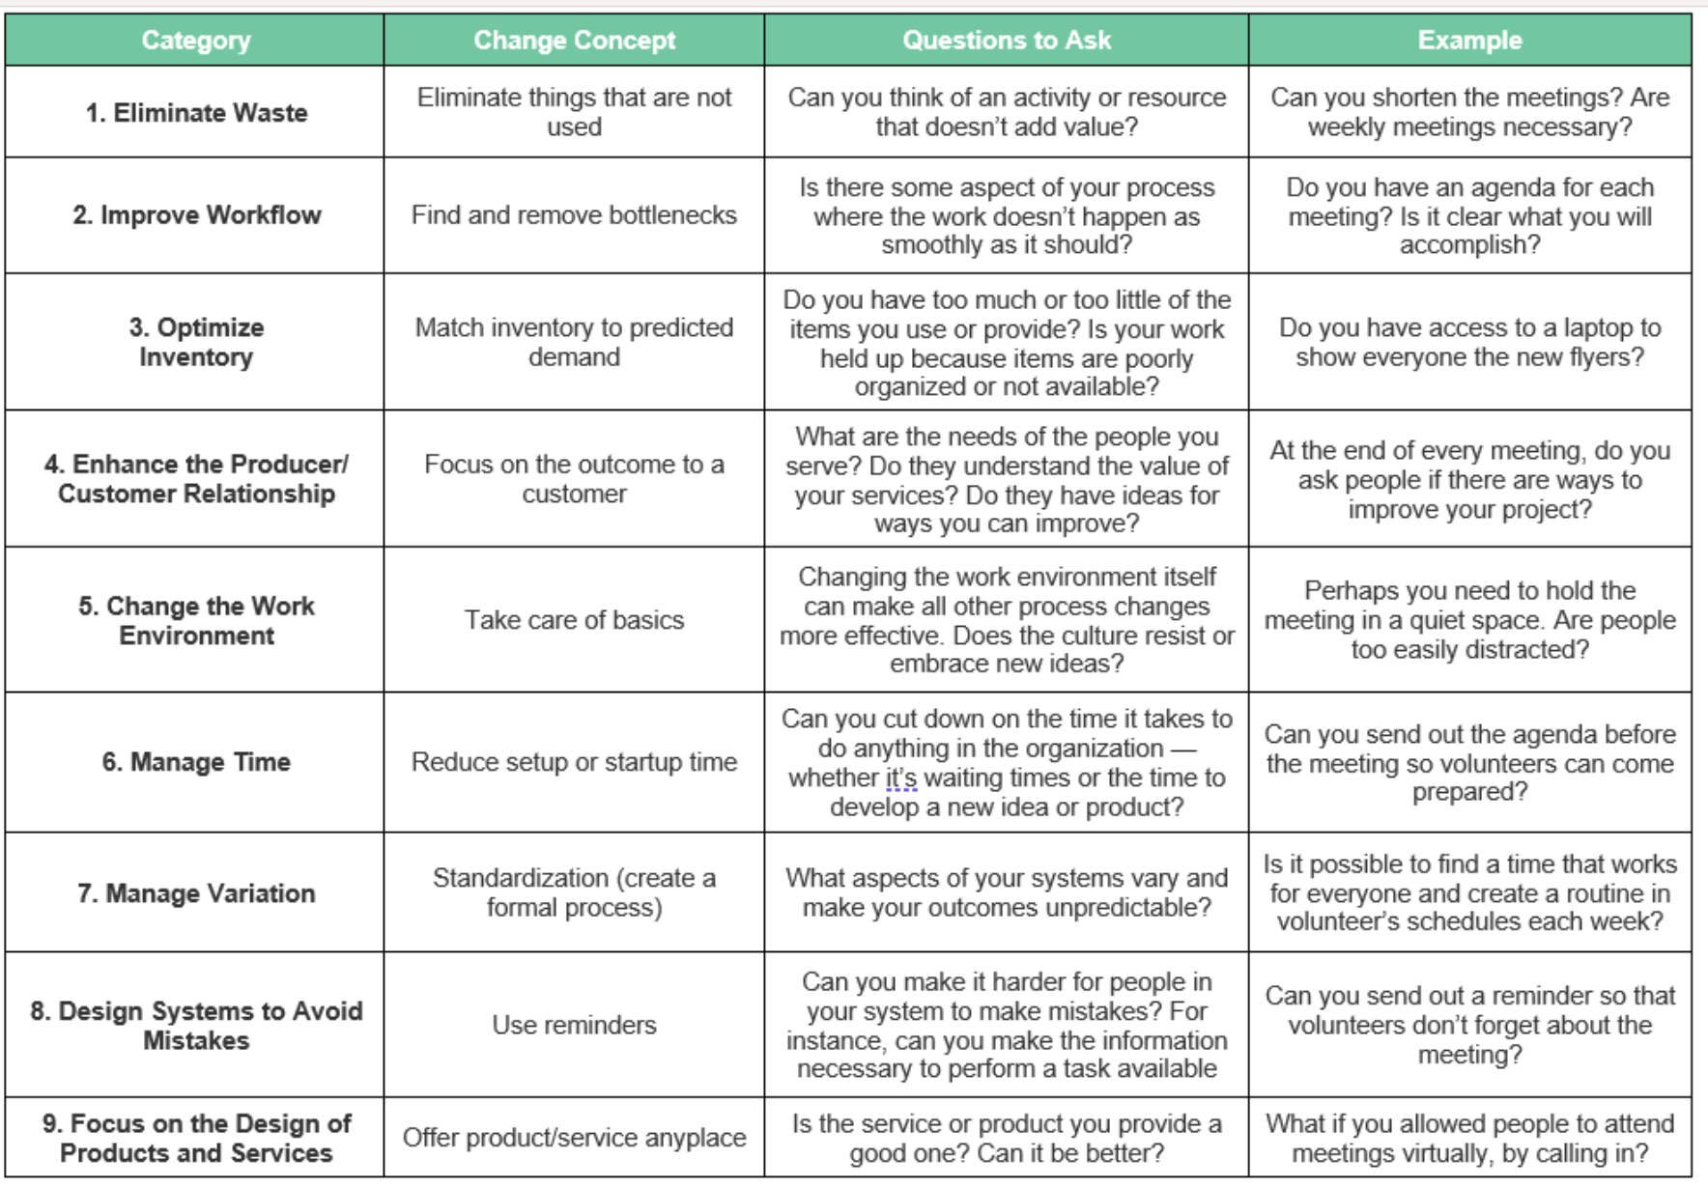
How do you use change concepts?
Example: Get volunteers to show up to meetings.
Task: Pick one change concept from each of the nine categories and help your team come up with some changes to test.
Notes:
Illustrate concepts #1 and 6
After using change concepts to brainstorm, you have many ideas for improvement: Move the volunteer meetings to a different night; move them to a different location; make them shorter; provide food and play music; review everyone’s accomplishments publicly; send out a reminder email.
Now that you’ve seen how to use change concepts for personal improvement, we’ll look at some clinical examples.

Slide 25
How do you use change concepts?
Clinical examples
Eliminating waste
A hospital implemented a computerized medication administration record system to eliminate multiple entries
A hospital team discovered that x-ray technicians were generating excess waste because they were not able to recycle the canisters that contained the x-ray film. The team persuaded a major producer of x-ray film to let the hospital return the canisters for refills.

Slide 26
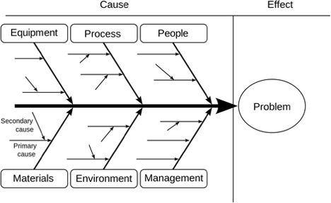
Identifying problems and generating ideas for improvement
Cause and effect diagram or Ishikawa or Fishbone diagram
Notes:
In the healthcare field, a cause-and-effect diagram (fishbone diagram) is a tool that assists in analyzing the root cause of a quality-related problem, such as poor performance or safety incidents. This tool allows the team to focus on the root cause of a given problem instead of the symptoms. When there is more than one root cause, the team may need to address each one with a separate fishbone diagram process.
A fishbone diagram is a visual aid that displays the relationship between the various factors that contribute to a particular effect or problem (i.e., causes and effects) in a way that resembles the bone of a fish. The fishbone diagram and the “five-whys” technique are commonly used together to identify the root cause of a problem.
To create a cause-and-effect diagram, write the effect in a box on the right-hand side of the page.
Then draw a horizontal line across the page.
Decide on a few categories or causes for the problem.
Useful categories of causes in the classic fishbone diagram include people, methods, materials, equipment, and environment.
Then we can draw a diagonal line to each of these, and these are actually the bones of the fish — and hence, its name.
The process of categorizing potential causes may be very useful to help you to break down a complex problem and focus in on it from various perspectives.
So as you're looking at each of the categories, you want to generate a list of causes.

Slide 27
Example
In 2018 and 2019, Nyaho Medical Centre (NMC) recorded a high number of needlestick injuries among staff. This led to the launch of a campaign to raise awareness of needlestick injury risks, processes for reporting and collecting data, and the initiation of a quality improvement project aimed at reducing needlestick injuries among staff at NMC.
Kumah A, Forkuo-Minka 2023
Notes:
Lets try this with a clinical example.
In 2018 and 2019, Nyaho Medical Centre (NMC) recorded a high number of needlestick injuries among staff. This led to the launch of a campaign to raise awareness of needlestick injury risks, processes for reporting and collecting data, and the initiation of a quality improvement project aimed at reducing needlestick injuries among staff at NMC. A fishbone diagram was developed to identify and visually display the many possible causes related to the high incidence of needlestick injuries in the facility.

Slide 28
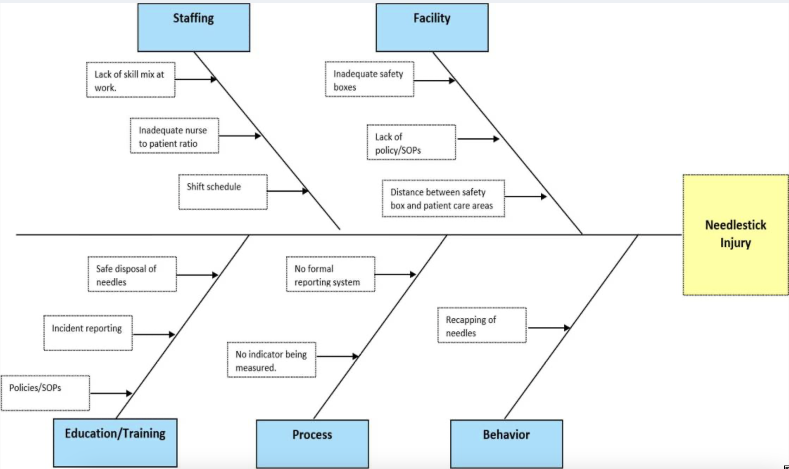
Example
Kumah A, Forkuo-Minka 2023
Notes:
<describe the fish bone>
This process helped the facility to test improvement ideas that ultimately led to the reduction of needlestick injuries in NMC from 11 cases in 2018 to 2 cases in 2021.

Slide 29
References
Kumah A, Forkuo-Minka AO. Advancing staff safety: assessment of quality improvement interventions in reducing needlestick injuries among staff at Nyaho Medical Centre. Glob J Qual Saf Healthc. 2023;6: 55–61.
IHI Course QI 102, Lesson 2
IHI Course QI 102, Lesson 3
IHI Course QI 102, Lesson 4

