Slide 1
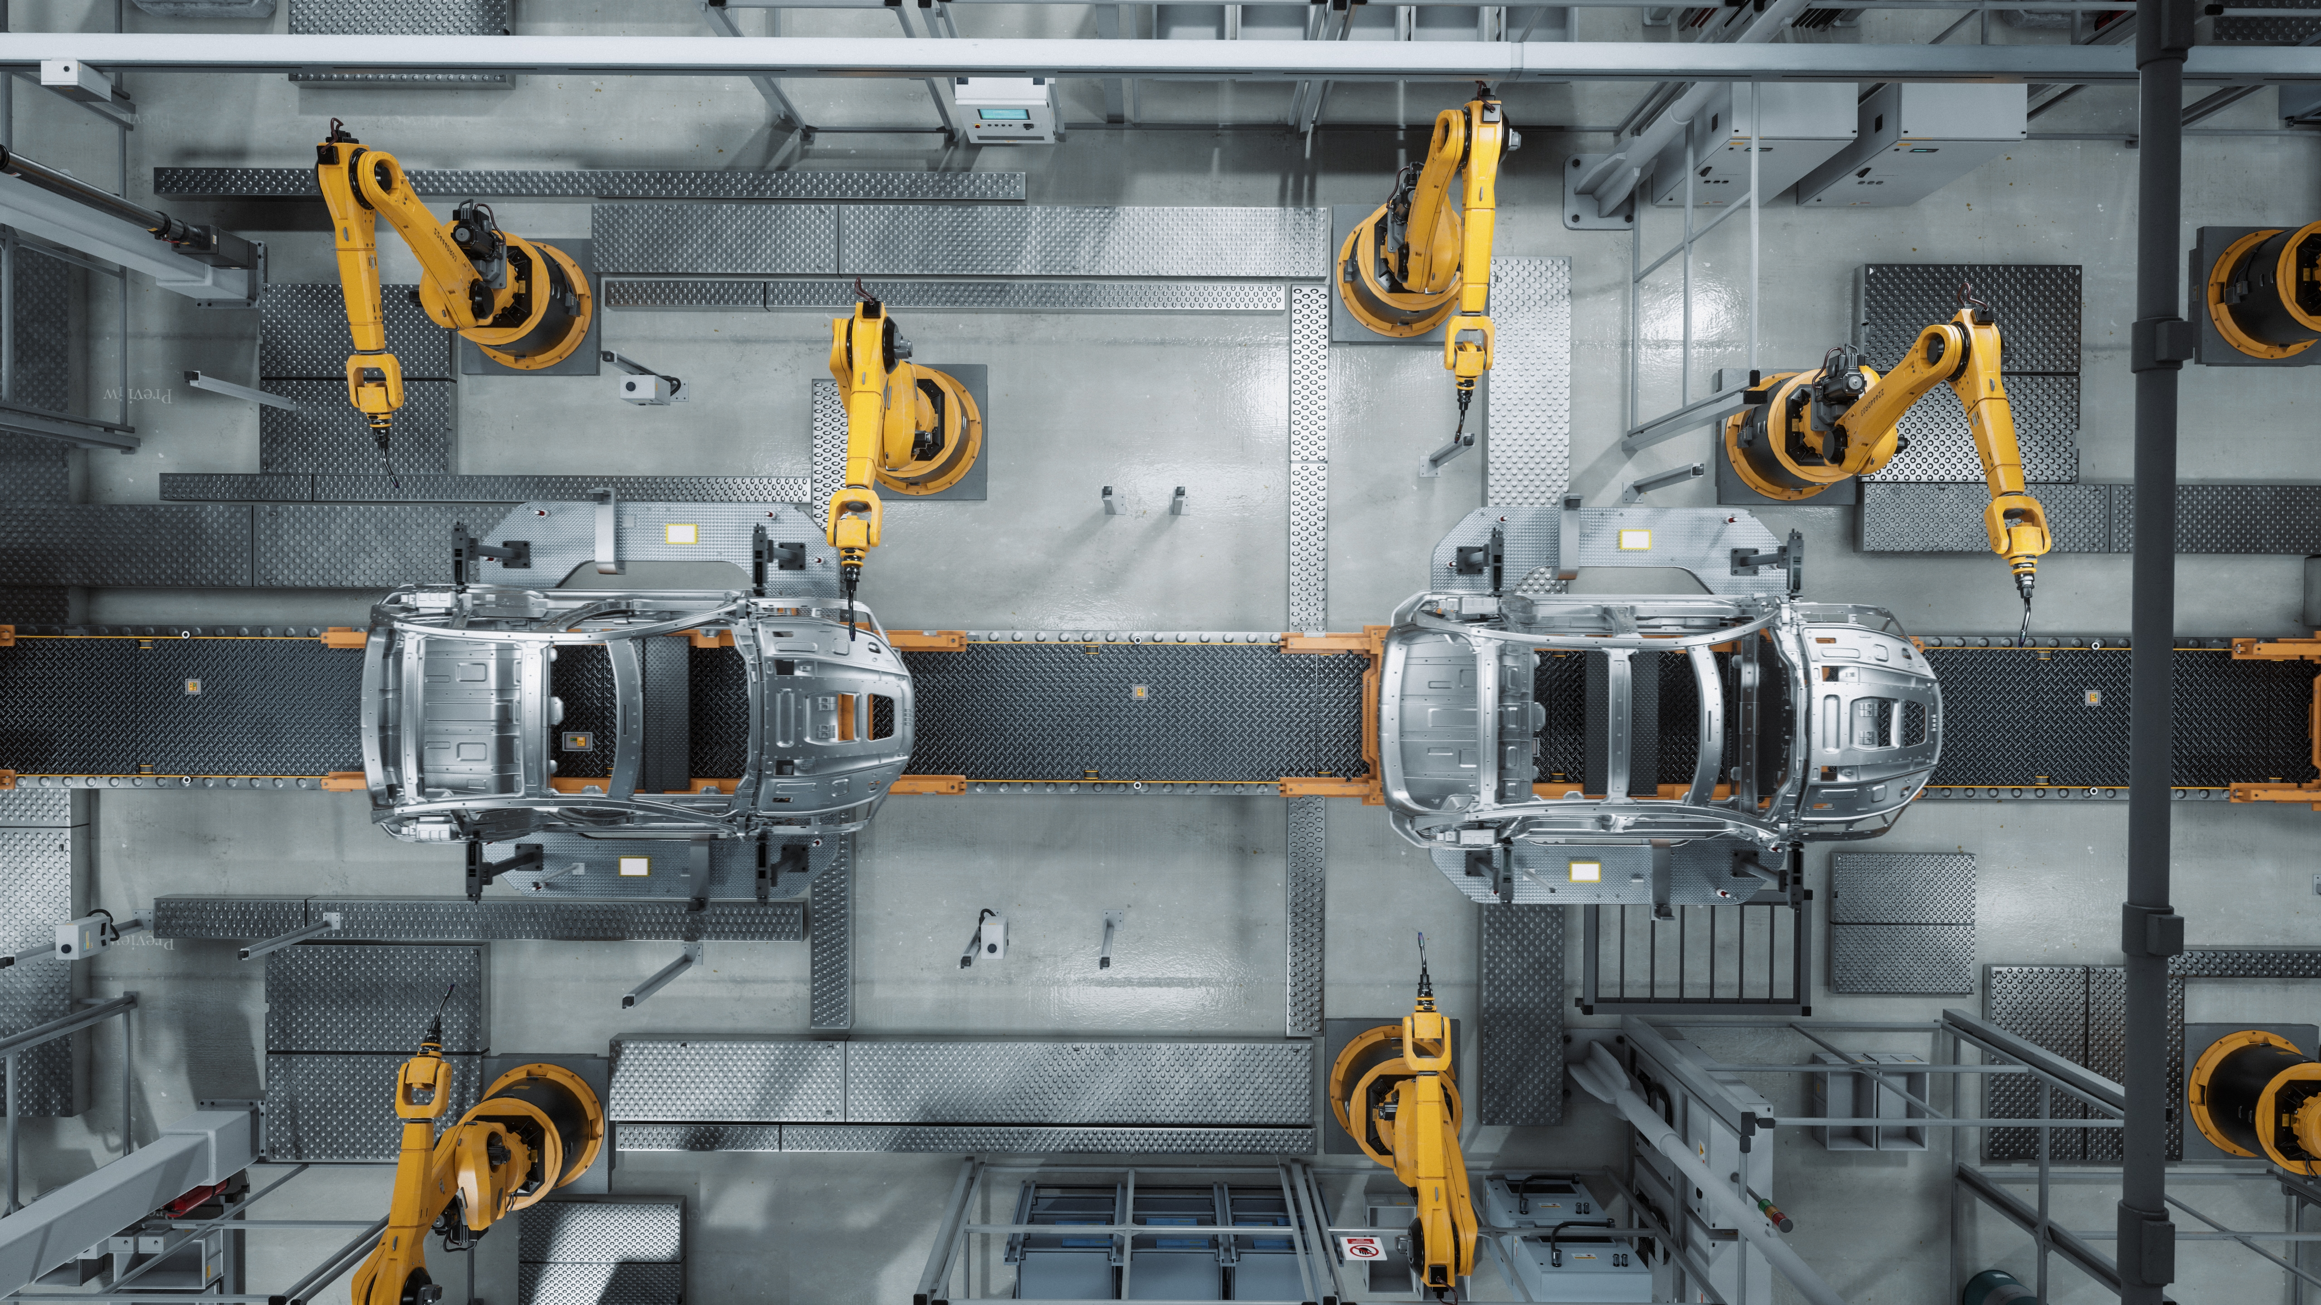

Leadership Management in Healthcare
Quality Improvement: Introduction
Lonika Sood, MBBS MHPE FACP
Associate Professor of Medical Education and Clinical Sciences
Course Director, LMH 521

Slide 2
Disclosure
No relevant financial disclosures
Adapted from the Institute for Healthcare Improvement modules on Patient safety
Use statement
WARNING: COPYRIGHT RESTRICTIONS This course content and all writings and materials provided to you at the Elson S. Floyd College of Medicine are protected by federal copyright law and Washington State University policy. The content is copyrighted by the Washington State University Board of Regents or licensed to the Elson S. Floyd College of Medicine by the copyright owner. Limited access to this content is given for personal academic study and review purposes of registered students and faculty of Elson S. Floyd College of Medicine. You shall not otherwise copy, share, distribute, modify, transmit, upload, post, republish, reuse, sell, gift, rent, lend or otherwise disseminate any portion of this course content without permission in writing, signed by an individual authorized by Washington State University. Unless otherwise noted, images © stock.adobe.com.

Slide 3


Collaboration
Please reach out with your thoughts and questions! Lonika.sood@wsu.edu
This is a safe learning environment.

Slide 4
Objectives
After completing this lesson, you will be able to:
State the three fundamental questions that are the basis of the Model for Improvement.
Identify the processes that make up the Plan-Do-Study-Act (PDSA) cycle.
Describe how a health care team has used the Model for Improvement to bring about improvements in a clinical setting.
Use the Model for Improvement to begin your own personal improvement project.

Slide 5
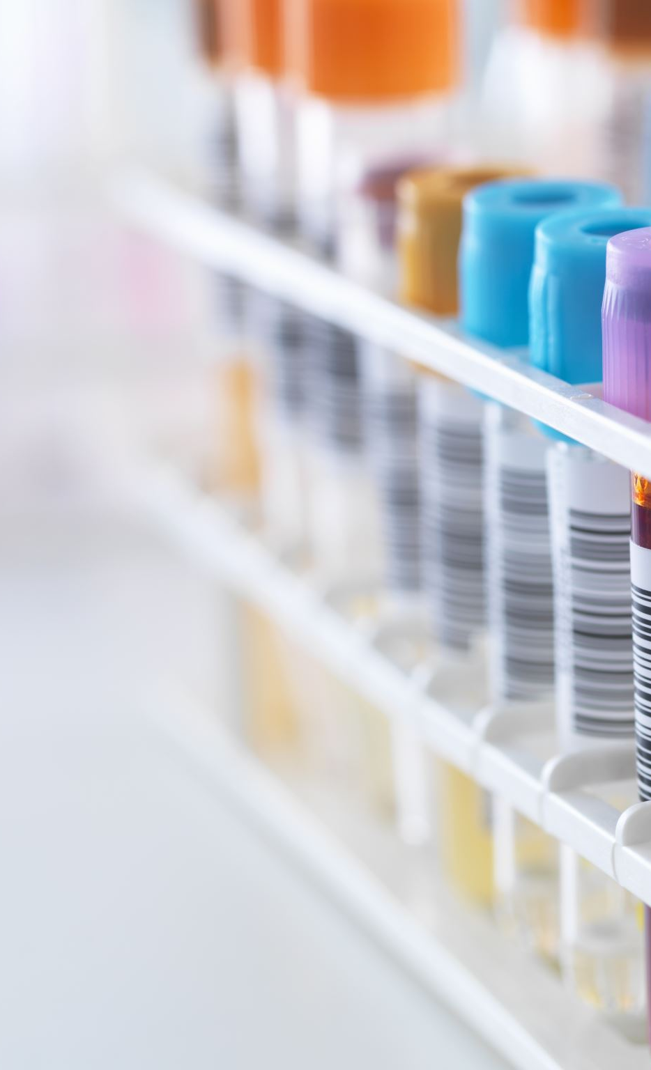
Case study
The Hospital
In 2005, the Saudi Aramco Medical Services Organization (SAMSO), a complex of hospitals in Saudi Arabia, set out to reduce the rate of central line infections in its NICU.
For every 1,000 days that patients were equipped with central lines, there were about 11 related infections.

Slide 6
Case study
The Hospital
SAMSO used the Model for Improvement to reduce that number.
Within a year, the rate of central line infections in the unit was down to zero
How did they do it?

Slide 7
Quality Improvement – Why does it matter?
Will
Ideas
Execution
Whether your goal is to reduce central line infections in the NICU or to get more sleep and exercise in your daily life, the basic principles of improvement are the same.
Every system is perfectly designed to get the results it gets
Essential elements for systems improvement: “Will, ideas, and execution.”
(Model for improvement)
Notes:
Whether your goal is to reduce central line infections in the NICU or to get more sleep and exercise in your daily life, the basic principles of improvement are the same.
Every system is perfectly designed to get the results it gets
Essential elements for systems improvement: “Will, ideas, and execution.”

Slide 8
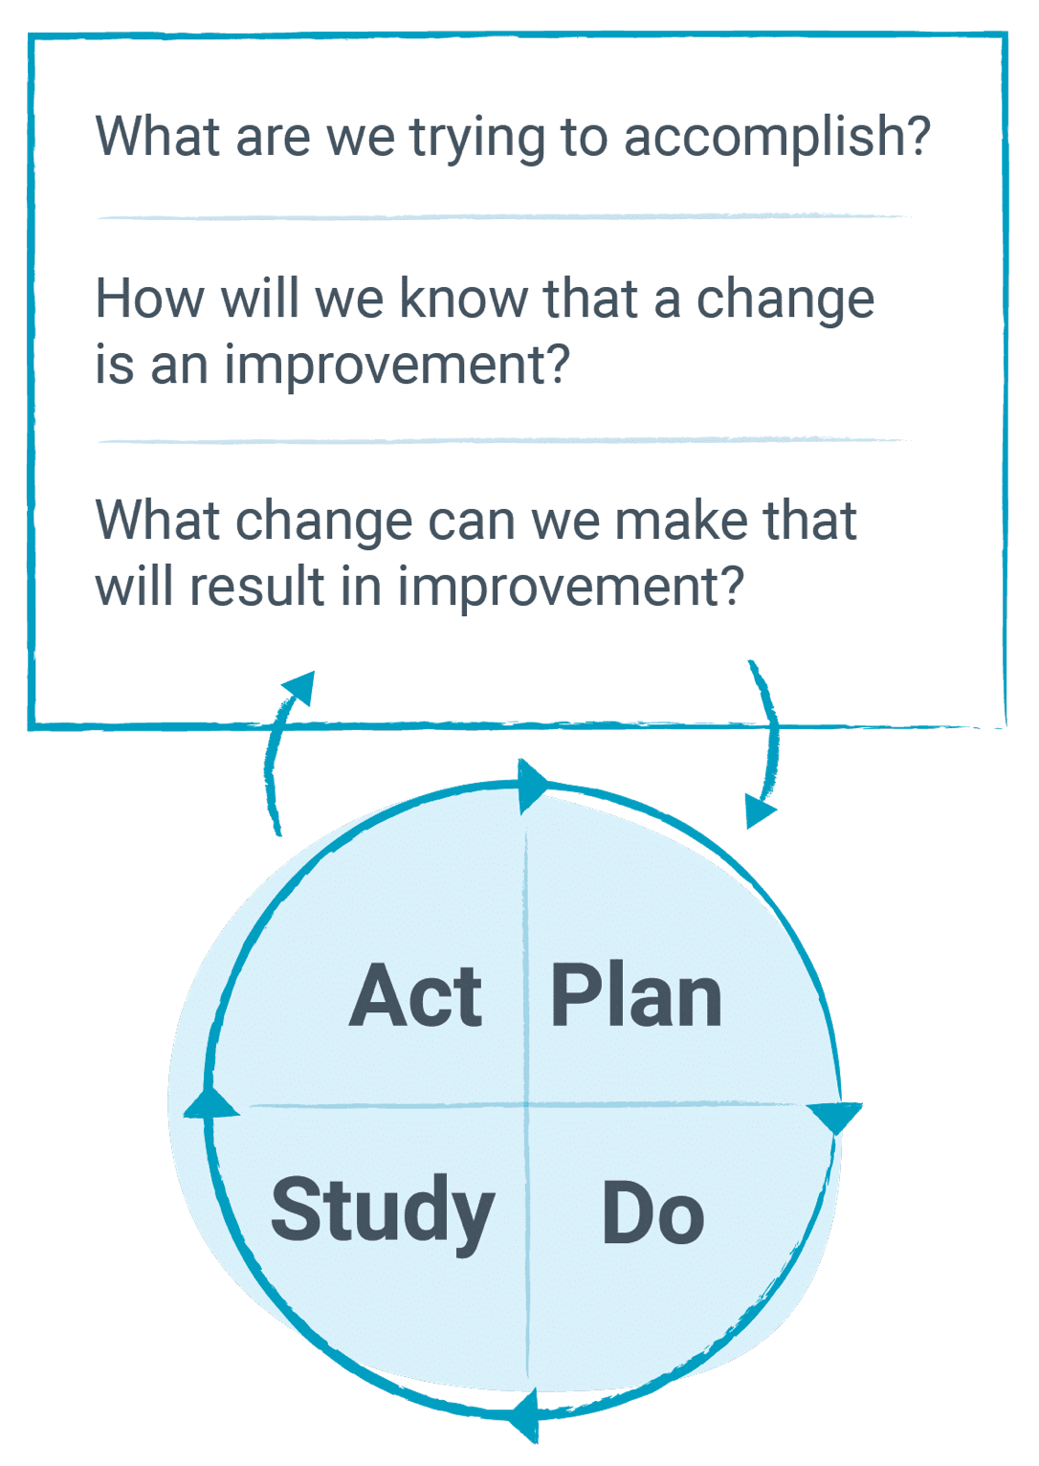
Model for Improvement
PDSA cycle
How to ask the right questions and then the PDSA cycle
Video: Link here
Notes:
Improvement begins with three fundamental questions.
The image shows The Model for Improvement. The model begins with three fundamental questions:¹

Slide 9
PDSA cycle
Set an aim
Establish measures
Identify changes
Test changes
Implement changes

Slide 10
Case study
The Hospital
How the Saudi Arabian NICU team used the Model for Improvement to cut their central line infections to zero

Slide 11
Case study
The Hospital
The aim was to decrease the infection rate in the NICU from 11 infections per 1,000 catheter days to fewer than 5 infections per 1,000 catheter days in nine months.
Set an aim
Establish measures
Identify changes
Test changes
Implement changes

Slide 12
Case study
The Hospital
The team measured the rate at which babies were getting bloodstream infections — their outcome measure. They also measured how often staff members were actually doing the things they were asked to do to prevent infection — their process measures.
Set an aim
Establish measures
Identify changes
Test changes
Implement changes

Slide 13
Case study
The Hospital
Tested several changes:
Having staff implement a set of interventions that evidence showed would reduce the rate of central line infections
Instituting a checklist that staff would review during a time-out before inserting the central line.
Requiring staff to place red tags on the beds of the babies with central lines
Set an aim
Establish measures
Identify changes
Test changes
Implement changes

Slide 14
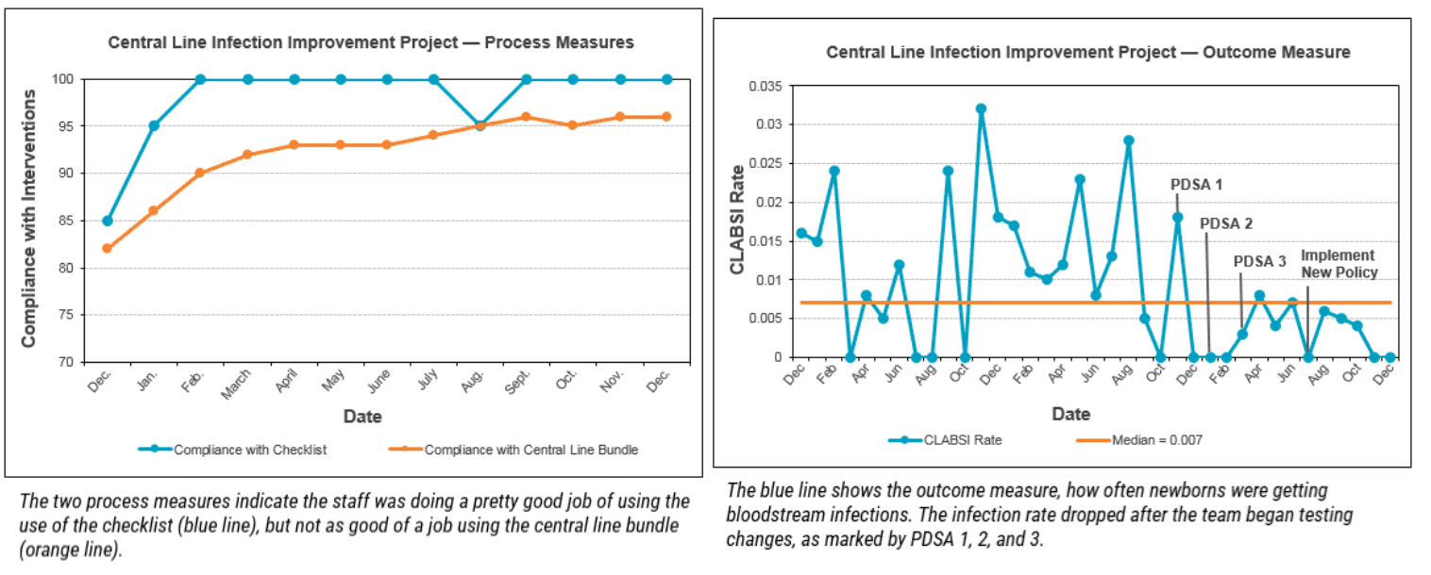
Case study
The Hospital
PDSA cycle
Set an aim
Establish measures
Identify changes
Test changes
Implement changes
Notes:
Here’s where the PDSA cycle came in. Dr. Cheriyan’s team trained the unit’s staff on all the changes and testing each change on a small scale. They learned from each test and measured how well everyone stuck to the new protocol.
After studying the data, the team used additional PDSA cycles to tweak the process so that staff would comply with the five-step bundle more often and continued to see improvement.

Slide 15
Case study
The Hospital
Once they had refined the process changes through several PDSA cycles, the team created a new policy governing the placement and care of central lines
Started training everyone who rotated through the unit
Set an aim
Establish measures
Identify changes
Test changes
Implement changes
Notes:
Here’s where the PDSA cycle came in. Dr. Cheriyan’s team trained the unit’s staff on all the changes and testing each change on a small scale. They learned from each test and measured how well everyone stuck to the new protocol.
After studying the data, the team used additional PDSA cycles to tweak the process so that staff would comply with the five-step bundle more often and continued to see improvement.

Slide 16
Other models of improvement
Six Sigma
Focuses on reducing variation
Steps:
  Define the problem in detail.
  Measure defects (in terms of “defects per million,” or Sigma level).
  Analyze under what conditions defects occur by using process measures, flow charts, and defect analysis.
  Improve by defining and testing changes aimed at reducing defects.
  Control your results by determining what steps you will take to maintain performance.

Slide 17
Other models of improvement
Lean
Focuses on improving value from the customer’s point of view, by reducing waste of time and resources.
Specify the value desired by the customer.
Identify the value stream for each product providing that value and challenge all of the wasted steps currently necessary to provide it.
Make the product flow continuously through the remaining value-added steps.
Introduce pull between all steps where continuous flow is not possible.
Manage toward perfection so that the number of steps and the amount of time and information needed to serve the customer continually fall.

Slide 18
References
IHI Course QI 102, Lesson 1

