Slide 1



Leadership Management in Healthcare
Patient safety – Why it matters?
Lonika Sood, MBBS MHPE FACP
Associate Professor of Medical Education and Clinical Sciences
Course Director, LMH 521
Notes:
In this lecture, we will go beyond the numbers to hear from people who have experienced harm from the health care system and learn how it has changed their lives. We will explore the reasons that providing safe care isn’t always easy in the clinical environment.
We will then move on to discuss the component parts of a culture of safety, including psychological safety, accountability, and teamwork and communication. Much of this can be extrapolated from your leadership training in the preclerkship. Through different scenarios, you’ll learn about the structures and behaviors that contribute to a culture of safety and see these elements at work.

Slide 2
Disclosure
No relevant financial disclosures
Adapted from the Institute for Healthcare Improvement modules on Patient safety
Use statement
WARNING: COPYRIGHT RESTRICTIONS This course content and all writings and materials provided to you at the Elson S. Floyd College of Medicine are protected by federal copyright law and Washington State University policy. The content is copyrighted by the Washington State University Board of Regents or licensed to the Elson S. Floyd College of Medicine by the copyright owner. Limited access to this content is given for personal academic study and review purposes of registered students and faculty of Elson S. Floyd College of Medicine. You shall not otherwise copy, share, distribute, modify, transmit, upload, post, republish, reuse, sell, gift, rent, lend or otherwise disseminate any portion of this course content without permission in writing, signed by an individual authorized by Washington State University. Unless otherwise noted, images © stock.adobe.com.

Slide 3


Collaboration
Please reach out with your thoughts and questions! Lonika.sood@wsu.edu
This is a safe learning environment. Given the nature of this topic, some of these stories describe events that might be traumatic.

Slide 4
Objectives
After completing this lesson, you will be able to:
Summarize the scope of the problem of harm to patients within the health care system.
Describe the effect of health care-associated harm on patients and families.
Explain why blaming and punishing individuals for errors rarely improves patient safety.

Slide 5
Patient safety
From the moment you enter the health system, you depend on the people providing care to correctly diagnose your problems, provide effective treatment, and ensure your safety.
But does it always happen that way?
Notes:
From the moment you enter the health system, you depend on the people providing care to correctly diagnose your problems, provide effective treatment, and ensure your safety.

Slide 6

*Content warning: Child death
Do no harm
Patient story
Josh
Click here or wait for the next slide to hear Josh’s story: Open link
Notes:
One of the core ethics principles in medicine is “do no harm.” If you poll a group of health care professionals, it is likely all would say they strive to embrace this motto in their practice. And yet, patients are inadvertently harmed every day in the health care system, sometimes with severe consequences.
The following video highlights how errors can have devastating results. Please open the video to hear from Josh’s father - Josh was a young child who had been in a motor vehicle accident. During his hospital care, a medical error occurred.

Slide 7

*Content warning: Child death
Do no harm
Patient story
Josh
Notes:
One of the core ethics principles in medicine is “do no harm.” If you poll a group of health care professionals, it is likely all would say they strive to embrace this motto in their practice. And yet, patients are inadvertently harmed every day in the health care system, sometimes with severe consequences.
The following video highlights how errors can have devastating results. Please open the video to hear from Josh’s father - Josh was a young child who had been in a motor vehicle accident. During his hospital care, a medical error occurred.

Slide 8
Adverse events in health care happen all the time
1
About 1 in 4 patients experiences an adverse event during hospitalization
About 1 in 2 hospitalizations has a medication error or adverse drug event
About 1 in 5 surgical patients experience a significant adverse event ADR intraoperatively
About 1 in 10 hospitalized patients experiences a healthcare associated infection
More than 12 million patients each year experience a diagnostic error in outpatient care
Notes:
Although the results are not always as devastating as what happened to Josh, the reality is adverse events in health care happen all too often. Studies of different health care settings in the United States have found:
About 1 in 4 patients experiences an adverse event during hospitalization
About 1 in 2 hospitalizations has a medication error or adverse drug event
About 1 in 5 surgical patients experience a significant adverse event ADR intraoperatively
About 1 in 10 hospitalized patients experiences a healthcare associated infection
More than 12 million patients each year experience a diagnostic error in outpatient car

Slide 9

Patient story
Rosemary
Click here or wait for the next slide to hear Rosemary’s story: Open link
Notes:
The consequences of these adverse events can be physical, emotional, and/or financial. Take a moment to consider Rosie Bartel’s experience. When she contracted an infection from the health care system, she lost more than her leg.

Slide 10

Patient story
Rosemary
Notes:
The consequences of these adverse events can be physical, emotional, and/or financial. Take a moment to consider Rosie Bartel’s experience. When she contracted an infection from the health care system, she lost more than her leg.

Slide 11

Patient safety
…. prevention of errors and adverse effects to patients associated with health care²
Notes:
The simplest definition of patient safety is the prevention of errors and adverse effects to patients associated with health care.¹
Patients are inadvertently harmed every day in health care systems, sometimes with severe consequences. And some — but not all — harm to patients is the result of human error. No matter how well-intentioned, well-trained, and hard-working, health professionals are human and make mistakes. Even Dr. Don Berwick, the founder of IHI, will tell you about errors he has made.
Click on the play button to watch the video.

Slide 12
Evolution of patient safety^{3,4,5,6}
1999: Institute of Medicine (IOM) released its landmark report, To Err Is Human, which revealed that between 44,000 and 98,000 died each year in US hospitals due to medical errors and adverse events.
“Faulty systems, processes, and conditions that lead people to make mistakes or fail to prevent them” were usually to blame for patient harm
Within days of the report, new legislation tasked the US Agency for Healthcare Research and Quality with studying health care quality
Notes:
As the patient safety field has evolved, it has moved away from the term “medical error,” which tends to overemphasize the role of individuals in causing harm. Informed by other high-consequence industries and the science of safety, exploring the real root causes of harm means looking far beyond individual clinicians; it means taking a close look at the systems in which they work.
Today, the movement encompasses much more: designing health care systems that reliably deliver the best outcomes to patients at the lowest cost.
In 1999, the Institute of Medicine (IOM) released its landmark report, To Err Is Human, which revealed that between 44,000 and 98,000 died each year in United States hospitals due to medical errors and adverse events. More recently, estimates of adverse event mortality reach approx. 250,000 patients annually.
It did not identify the main cause of the problem to be reckless or incompetent providers. “Faulty systems, processes, and conditions that lead people to make mistakes or fail to prevent them” were usually to blame for patient harm, according to the IOM report.
Within days of the report, new legislation tasked the US Agency for Healthcare Research and Quality with studying health care quality. Over the next five years, the rate of English-language articles published on patient safety almost tripled.

Slide 13
Most health care professionals are drawn to health care out of a desire to help others…. Then why is it that so many adverse events occur?
Technology evolves
Answer not clear
Not enough time
Complex care
Hierarchical health care abuse

Slide 14
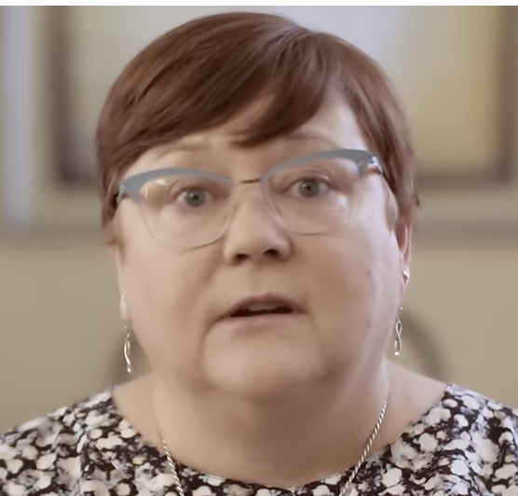
Clinician story
Nurse Gwen Cox
Click here or wait for the next slide to hear Nurse Gwen’s story: Open link
Notes:
Errors do not affect the patient or their families alone. They are deeply impactful for the people involved. Take a moment to listen to Nurse Gwen Cox on how a mistake impacted her identity and her advocacy for patient safety.

Slide 15
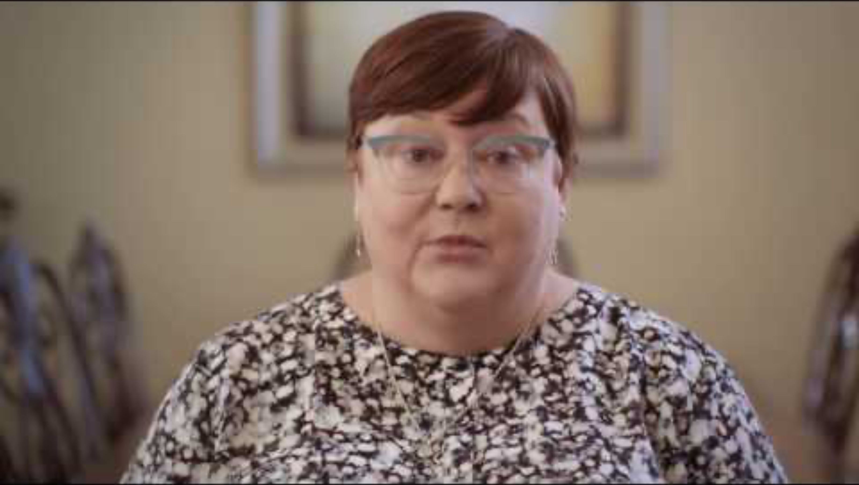
Clinician story
Nurse Gwen Cox
Notes:
Errors do not affect the patient or their families alone. They are deeply impactful for the people involved. Take a moment to listen to Nurse Gwen Cox on how a mistake impacted her identity and her advocacy for patient safety.

Slide 16

How is healthcare more complex… and how does this relate to patient safety
Click here or wait for the next slide: Open link
Notes:
How is healthcare more complex… and how does this relate to patient safety
Watch this video to hear how the diagnosis and care of patients with breast cancer has evolved over time to become more complex.

Slide 17
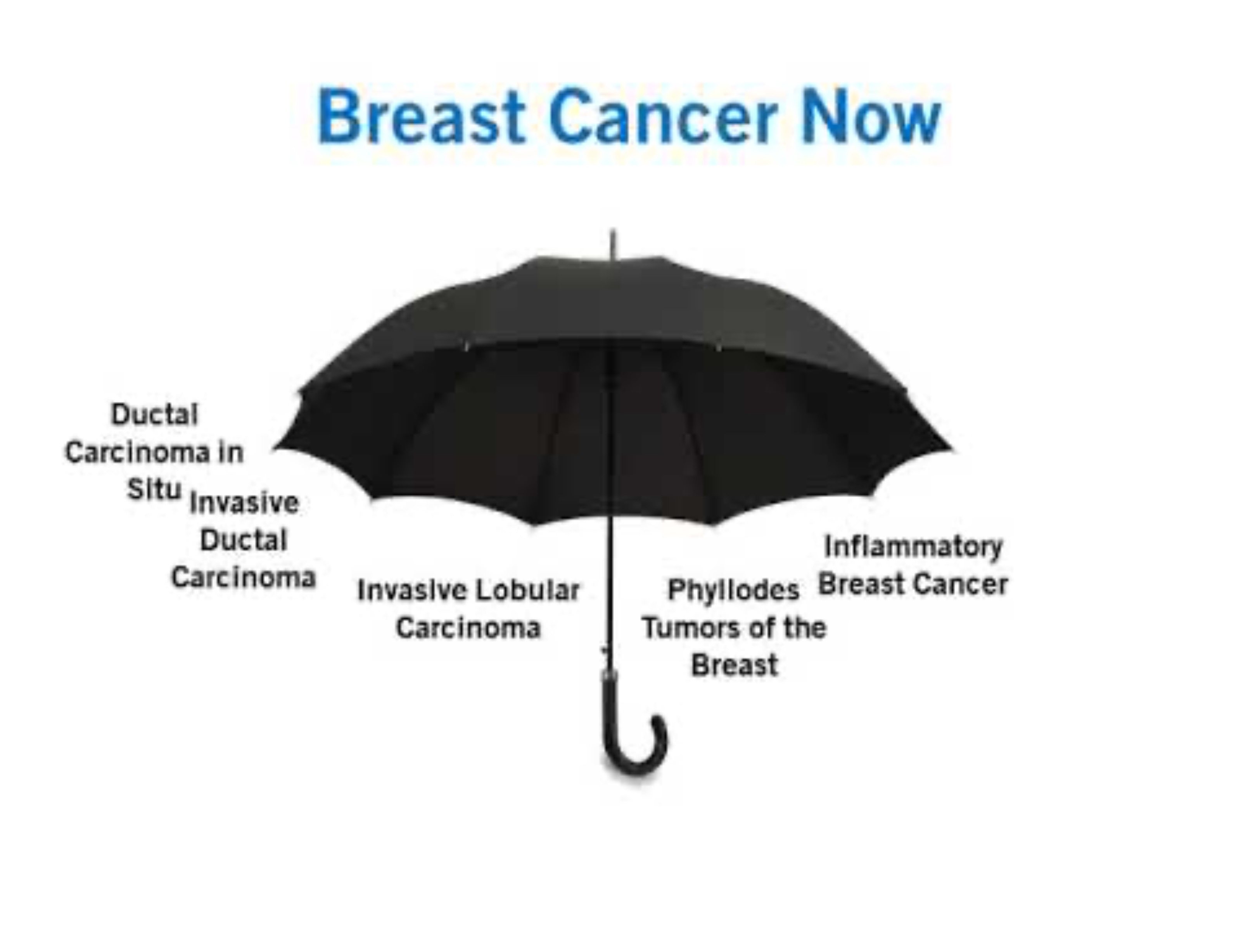
How is healthcare more complex… and how does this relate to patient safety
Notes:
How is healthcare more complex… and how does this relate to patient safety
Watch this video to hear how the diagnosis and care of patients with breast cancer has evolved over time to become more complex.

Slide 18
Blame & Punishment Are Not Solutions
It is human nature to look for someone or something to blame when things don’t go according to plan
Patients and family members are not the only people harmed by medical error.
‘The single greatest impediment to error prevention in the medical industry is that we punish people for making mistakes’⁷
Delivering the right care — for every patient, every time — requires a different way of thinking about error in medicine and a new approach to preventing harm.
Notes:
It is human nature to look for someone or something to blame when things don’t go according to plan.
Historically, the medical profession has viewed medical errors and adverse events as either an inevitable byproduct of complex care or the result of clinician incompetence, often seeking to blame the clinicians involved in the error. Yet most of the time these situations occurred unintentionally.
Patients and family members are not the only people harmed by medical error. Clinicians suffer, too. Blaming people who are doing their best does not solve the problems that lead to error, and it makes health care less safe.
“The single greatest impediment to error prevention in the medical industry is that we punish people for making mistakes.”
Delivering the right care — for every patient, every time — requires a different way of thinking about error in medicine and a new approach to preventing harm.

Slide 19

Learning from the airline industry
In 1977, a pilot made an error that led to the collision of two jumbo jets on a runway in Tenerife, killing more than 500 people in one of aviation’s deadliest accidents
Video here: Link
Instead of blaming individuals, the aviation industry looked at the system as a whole, and learned how flawed processes and problems with the culture set those people up for failure.
Shift of focus from blame and punishment to system-level improvement → Number of airline accidents resulting in passenger harm has significantly decreased
Notes:
It took a terrible disaster for the aviation industry to learn that blame and punishment don’t improve safety.
In 1977, a pilot named Jacob Van Zanten made an error that led to the collision of two jumbo jets on a runway in Tenerife, killing more than 500 people in aviation’s deadliest accident. After the crash, industry leaders couldn’t blame the accident on mechanical failure or staff misbehavior, as they usually did, because Van Zanten was a revered pilot. In fact, magazines with his image were onboard at the time.
Instead of blaming individuals, the aviation industry looked at the system as a whole, and learned how flawed processes and problems with the culture set those people up for failure. Since this shift of focus from blame and punishment to system-level improvement, the number of airline accidents resulting in passenger harm has significantly decreased. Commercial air travel has become so reliable that even if you flew every day, it would take an average of 123,000 years to die in a plane crash.1 The industry has continually improved safety by learning from small mistakes, even those that do not cause harm.
Health care can and should do the same.

Slide 20
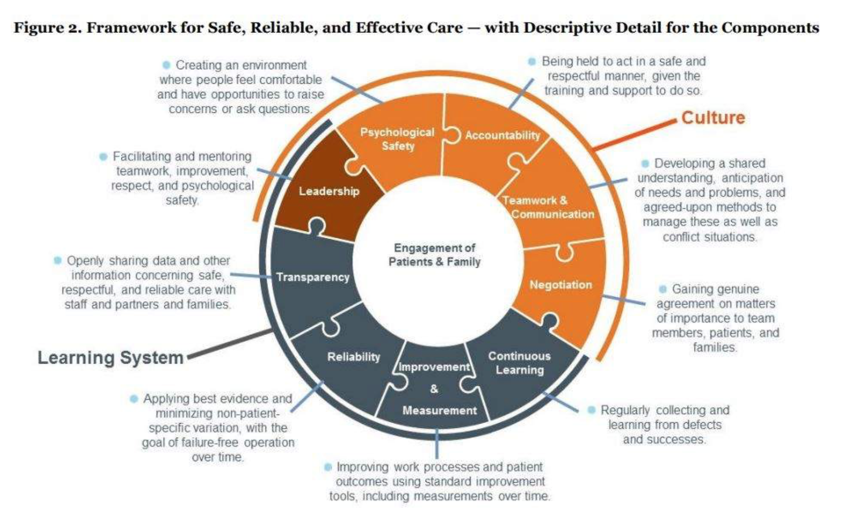
Framework for Patient Safety⁸
Notes:
The diagram outlines a framework for creating a safe, reliable, and effective care environment. The framework is built on Culture and Learning Systems each with their own pillars of support, where Leadership is a shared responsibility of both Culture and Learning Systems.
Leadership is considered facilitating and mentoring teamwork, improvement, respect and psychological safety.
The pillars supporting
Culture are:
Psychological Safety: Creating an environment where people feel comfortable and have opportunities to raise concerns or ask questions.
Accountability: Being held to act in a safe and respectful manner, given the training and support to do so.
Teamwork and Communication: Developing a shared understanding, anticipation of needs and problems, and agreed upon methods to manage these as well as conflict situations.
Negotiation: Gaining genuine agreement on matters of importance to team members, patients and families.
The pillars supporting Leadership are:
Continuous Learning: Regularly collecting and learning from defects and successes.
Improvement and Measurement: Improving work process and patient outcomes using standard improvement tools, including measurements over time.
Reliability: Applying best evidence and minimizing non-patient-specific variation, with the goal of failure-free operation over time.
Transparency: Openly sharing data and other information concerning safe, respectful, and reliable care with staff and partners and families.

Slide 21
Culture of Patient Safety

Slide 22
Psychological safety
Accountability
Negotiation
Teamwork and Communication
In a culture of safety …. clinicians discuss errors and harm openly, without fear of being unfairly punished, and with confidence that reporting safety issues will lead to improvement

Slide 23

Case study
The Hospital
Leaders of a large hospital implemented a new policy that nurses had to administer all medications within 30 minutes of the order. As a result, the nurses made sure to always check the medications out of the dispensing machine within 30 minutes, so that it appeared to supervisors that they had complied. However, they didn't always have time to deliver them right away. Sometimes, the nurses would have to carry the medications around in their pockets for quite a while until they had time to deliver them.
Has the hospital increased the quality and safety of care? Why or why not?

Slide 24

Psychological safety
… key to reducing the likelihood that a patient will get hurt
… has an impact on innovation and faster adoption of new ideas
Video: Open link
Notes:
Psychological safety is key to reducing the likelihood that a patient will get hurt.
It has other benefits, too, such as innovation and faster adoption of new ideas.
Amy Edmondson, a professor at Harvard Business School, is an expert in team performance. In a study of surgical teams, she and co-researchers found that when team members felt comfortable making suggestions, trying things that might not work, pointing out potential problems, and admitting mistakes, they were more successful in learning a new procedure. By contrast, when people felt uneasy acting this way, the learning process was stifled.¹
In the next video, Edmondson explains more about how psychological safety helps groups learn. Click on link to watch the video.

Slide 25

Psychological safety
Notes:
Psychological safety is key to reducing the likelihood that a patient will get hurt.
It has other benefits, too, such as innovation and faster adoption of new ideas.
Amy Edmondson, a professor at Harvard Business School, is an expert in team performance. In a study of surgical teams, she and co-researchers found that when team members felt comfortable making suggestions, trying things that might not work, pointing out potential problems, and admitting mistakes, they were more successful in learning a new procedure. By contrast, when people felt uneasy acting this way, the learning process was stifled.¹
In the next video, Edmondson explains more about how psychological safety helps groups learn. Click on link to watch the video.

Slide 26

Teamwork & Communication
Processes of health care are too complex to be safely carried out by individual experts
When patient care teams function as a group of individual experts and don’t take deliberate steps to ensure safety → increase the risk of error and patient harm

Slide 27

Role of Patients & Families
Helping to identify adverse events.
Helping to inform clinicians about adverse events they are not aware of
Behaving as advocates for their own health.

Slide 28
References
U.S. Department of Health and Human Services Office of Inspector General. Adverse Events in Hospitals: A Quarter of Medicare Patients Experienced Harm in October 2018
Health topics: patient safety(opens in a new tab). The World Health Organization website.
Kohn LT, Corrigan JM, Donaldson MS, eds.; Committee on Quality of Health Care in America, Institute of Medicine. To Err Is Human: Building a Safer Health System(opens in a new tab). Washington, DC: National Academies Press; 2000.
Makary M., Daniel M. Medical error—the third leading cause of death in the US. BMJ. 2016;353(opens in a new tab)
Stelfox HT, Palmisani S, Scurlock C, Orav EJ, Bates DW. The 'To Err Is Human' report and the patient safety literature. Quality and Safety in Health Care(opens in a new tab). June 2006;15(3):174–178.
Classen DC, Resar R, Griffin F, Federico F, Kimmel N, Whittington J, Frankel A. ‘Global Trigger Tool’ shows that adverse events in hospitals may be ten times greater than previously measured(opens in a new tab). Health Affairs. April 2011;30(4):581–589.
American College of Healthcare Executives and IHI/NPSF Lucian Leape Institute. Leading a Culture of Safety: A Blueprint for Success(opens in a new tab). Boston, MA: American College of Healthcare Executives and Institute for Healthcare Improvement; 2017.
Frankel A, Haraden C, Federico F, Lenoci-Edwards J. A Framework for Safe, Reliable, and Effective Care [white paper] Cambridge, Massachusetts: Institute for Healthcare Improvement and Safe & Reliable Healthcare; 2017.
IHI course PS 101, Lesson 1
IHI course PS 101, Lesson 2

Slide 29
Presenter Name and Email address
Office Hours:

