Slide 1
What is physical withdrawal from drugs of abuse?
Notes:
Title slide must have the WSU Elson S. Floyd College of Medicine logo. Use this link to download the logo: https://medicine.spokane.wsu.edu/administration/Communication%20%20Marketing%20Resources/Templates%20and%20Logos/Logo_WSU%20Elson%20S%20Floyd%20College%20of%20Medicine-horz-rgb.jpg

Slide 2
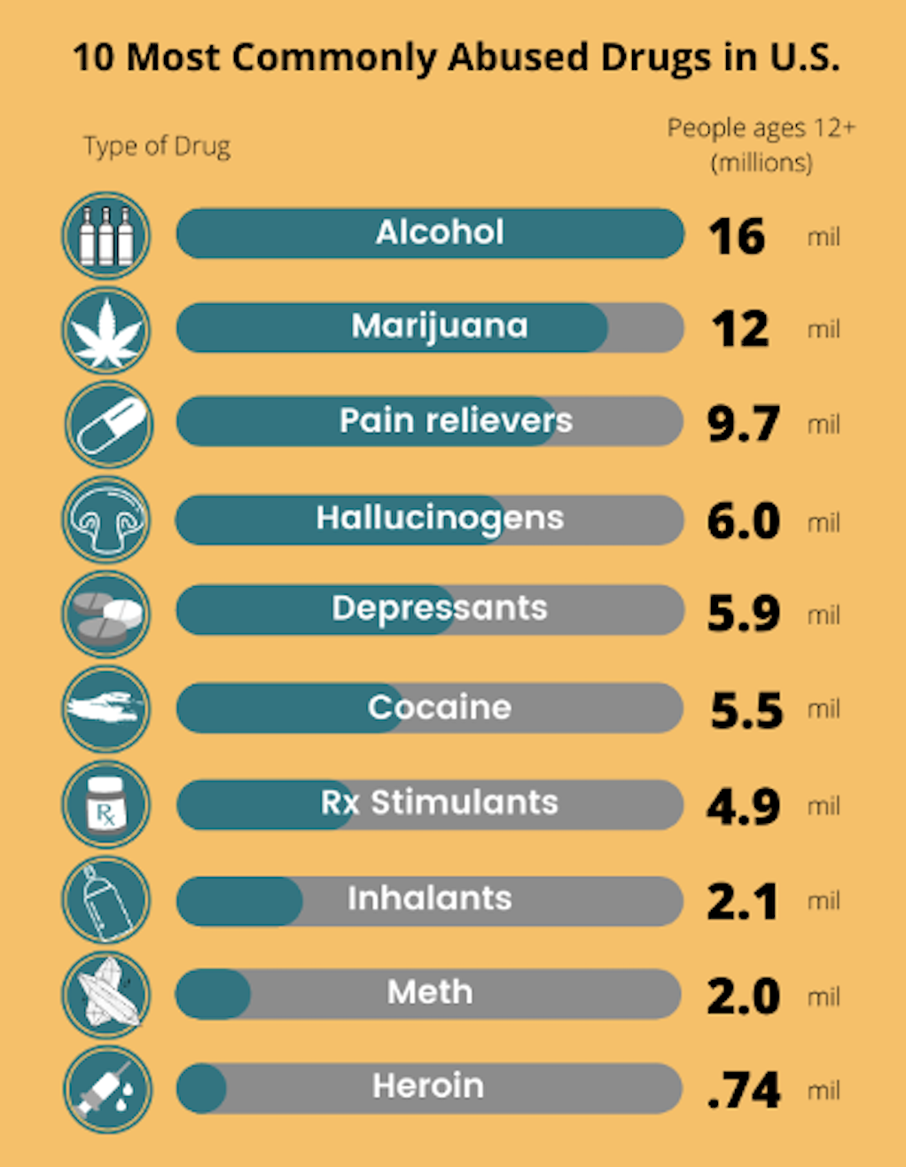
What are drugs of abuse and what do they have in common?
1º All drugs of abuse have the power to change brain function affecting behavior, mood, thoughts, and/or perception.
Notes:
Microsoft Office products, like Word and PowerPoint, retain the original image file. Cropping the image within Word and PowerPoint is not considered a permanent redaction as the cropped part is still accessible to any who receive the file. Placing boxes/etc over information to be redacted is also not permanent, as the boxes are easily moved to reveal patient information.

Slide 3
What are drugs of abuse and what do they have in common?
1º All drugs of abuse have the power to change brain function affecting behavior, mood, thoughts, and/or perception.
2º All drugs of abuse have the propensity to cause compulsive use and addiction.
Notes:
Microsoft Office products, like Word and PowerPoint, retain the original image file. Cropping the image within Word and PowerPoint is not considered a permanent redaction as the cropped part is still accessible to any who receive the file. Placing boxes/etc over information to be redacted is also not permanent, as the boxes are easily moved to reveal patient information.

Slide 4
What are drugs of abuse and what do they have in common?
1º All drugs of abuse have the power to change brain function affecting behavior, mood, thoughts, and/or perception.
2º All drugs of abuse have the propensity to cause compulsive use and addiction.
3º The frequent use of any drug of abuse will lead to the development of physical withdrawal.
Notes:
Microsoft Office products, like Word and PowerPoint, retain the original image file. Cropping the image within Word and PowerPoint is not considered a permanent redaction as the cropped part is still accessible to any who receive the file. Placing boxes/etc over information to be redacted is also not permanent, as the boxes are easily moved to reveal patient information.

Slide 5
Homeostasis, refers to any self-regulating process by which our biological systems work to adjust to different environmental conditions in order to keep our body in an optimal state for survival.
All biological systems attempt to maintain a "normal" balance, (homeostasis). The brain functions as the "overseer" of this balance by making various adjustments to maintain a well-functioning, biological system.
Drugs of abuse lead to changes in this normal balance. In order to return to that normal balance (homeostasis), with time, the brain develops strategies to minimize the effects of that drug.
Notes:
Microsoft Office products, like Word and PowerPoint, retain the original image file. Cropping the image within Word and PowerPoint is not considered a permanent redaction as the cropped part is still accessible to any who receive the file. Placing boxes/etc over information to be redacted is also not permanent, as the boxes are easily moved to reveal patient information.

Slide 6
In other words…
Our brain is always working to maintain our body in an optimal state for survival (homeostasis).
Notes:
Microsoft Office products, like Word and PowerPoint, retain the original image file. Cropping the image within Word and PowerPoint is not considered a permanent redaction as the cropped part is still accessible to any who receive the file. Placing boxes/etc over information to be redacted is also not permanent, as the boxes are easily moved to reveal patient information.

Slide 7
In other words…
Our brain is always working to maintain our body in an optimal state for survival (homeostasis).
Drugs of abuse impact how our biological systems function, moving our body away from that optimal state for survival.
Notes:
Microsoft Office products, like Word and PowerPoint, retain the original image file. Cropping the image within Word and PowerPoint is not considered a permanent redaction as the cropped part is still accessible to any who receive the file. Placing boxes/etc over information to be redacted is also not permanent, as the boxes are easily moved to reveal patient information.

Slide 8
In other words…
Our brain is always working to maintain our body in an optimal state for survival (homeostasis).
Drugs of abuse impact how our biological systems function, moving our body away from that optimal state for survival.
When we start to use a drug of abuse frequently, our brain “learns” to take the effect of that drug into account when it is working to maintain our homeostasis.
Notes:
Microsoft Office products, like Word and PowerPoint, retain the original image file. Cropping the image within Word and PowerPoint is not considered a permanent redaction as the cropped part is still accessible to any who receive the file. Placing boxes/etc over information to be redacted is also not permanent, as the boxes are easily moved to reveal patient information.

Slide 9
In other words…
Our brain is always working to maintain our body in an optimal state for survival (homeostasis).
Drugs of abuse impact how our biological systems function, moving our body away from that optimal state for survival.
When we start to use a drug of abuse frequently, our brain “learns” to take the effect of that drug into account when it is working to maintain our homeostasis.
It does that by stimulating biological responses that have the opposite effects of those produced by that drug.
Notes:
Microsoft Office products, like Word and PowerPoint, retain the original image file. Cropping the image within Word and PowerPoint is not considered a permanent redaction as the cropped part is still accessible to any who receive the file. Placing boxes/etc over information to be redacted is also not permanent, as the boxes are easily moved to reveal patient information.

Slide 10
In other words…
Our brain is always working to maintain our body in an optimal state for survival (homeostasis).
Drugs of abuse impact how our biological systems function, moving our body away from that optimal state for survival.
When we start to use a drug of abuse frequently, our brain “learns” to take the effect of that drug into account when it is working to maintain our homeostasis.
It does that by stimulating biological responses that have the opposite effects of those produced by that drug.
In this state, the brain takes in to account the effects of that drug when working to maitain homeostasis.
Notes:
Microsoft Office products, like Word and PowerPoint, retain the original image file. Cropping the image within Word and PowerPoint is not considered a permanent redaction as the cropped part is still accessible to any who receive the file. Placing boxes/etc over information to be redacted is also not permanent, as the boxes are easily moved to reveal patient information.

Slide 11
In other words…
Our brain is always working to maintain our body in an optimal state for survival (homeostasis).
Drugs of abuse impact how our biological systems function, moving our body away from that optimal state for survival.
When we start to use a drug of abuse frequently, our brain “learns” to take the effect of that drug into account when it is working to maintain our homeostasis.
It does that by stimulating biological responses that have the opposite effects of those produced by that drug.
In this state, the brain takes in to account the effects of that drug when working to maitain homeostasis.
Therefore, if the drug is not consumed, the brain’s “opposite drug response” is exaggerated, taking us away from our homeostasis and leading us to experience Physical Withdrawal from that substance!
Notes:
Microsoft Office products, like Word and PowerPoint, retain the original image file. Cropping the image within Word and PowerPoint is not considered a permanent redaction as the cropped part is still accessible to any who receive the file. Placing boxes/etc over information to be redacted is also not permanent, as the boxes are easily moved to reveal patient information.

Slide 12
In other words…
Our brain is always working to maintain our body in an optimal state for survival (homeostasis).
Drugs of abuse impact how our biological systems function, moving our body away from that optimal state for survival.
When we start to use a drug of abuse frequently, our brain “learns” to take the effect of that drug into account when it is working to maintain our homeostasis.
It does that by stimulating biological responses that have the opposite effects of those produced by that drug.
In this state, the brain takes in to account the effects of that drug when working to maitain homeostasis.
Therefore, if the drug is not consumed, the brain’s “opposite drug response” is exaggerated, taking us away from our homeostasis and leading us to experience Physical Withdrawal from that substance!
Different substances of abuse, such as marijuana, alcohol, cocaine and heroin, produce different effects in our body. As a result, the Physical Withdrawal symptoms (sensation) from each substance can be different.
Notes:
Microsoft Office products, like Word and PowerPoint, retain the original image file. Cropping the image within Word and PowerPoint is not considered a permanent redaction as the cropped part is still accessible to any who receive the file. Placing boxes/etc over information to be redacted is also not permanent, as the boxes are easily moved to reveal patient information.

Slide 13
Experiencing physical withdrawal from color:
The McCollough effect
Notes:
Microsoft Office products, like Word and PowerPoint, retain the original image file. Cropping the image within Word and PowerPoint is not considered a permanent redaction as the cropped part is still accessible to any who receive the file. Placing boxes/etc over information to be redacted is also not permanent, as the boxes are easily moved to reveal patient information.

Slide 14

For this exercise I want you to imagine that:
The white color represents your body in its optimal state for survival (homeostasis)
The red color represents the “pleasant feelings” produced by the use of a drug of abuse.
Opposite to red, the bluish-green color represents the “aversive feelings” produced by the physical withdrawal from that drug.
Notes:
Microsoft Office products, like Word and PowerPoint, retain the original image file. Cropping the image within Word and PowerPoint is not considered a permanent redaction as the cropped part is still accessible to any who receive the file. Placing boxes/etc over information to be redacted is also not permanent, as the boxes are easily moved to reveal patient information.

Slide 15
What ever you do, don’t take your eyes of the black dot!

Slide 19
Believe me, this slide is pure white.
If you are seeing it bluish-green, you are experiencing color withdrawal!

